Slide 1

Laser Shearography NDT:
Technological Advantages and Applications in the Marine Industry
Roland Wahler, Dantec Dynamics GmbH
BINDT: Marine Composites Inspection Workshop 2021, Poole

Slide 2
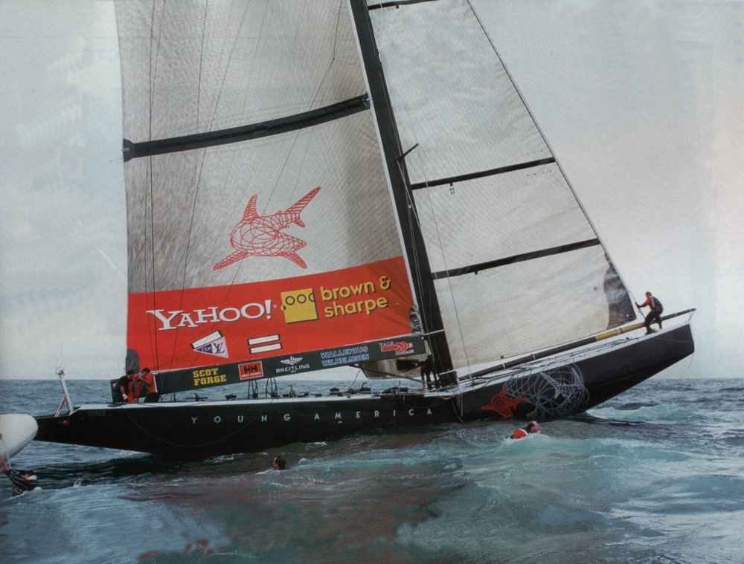
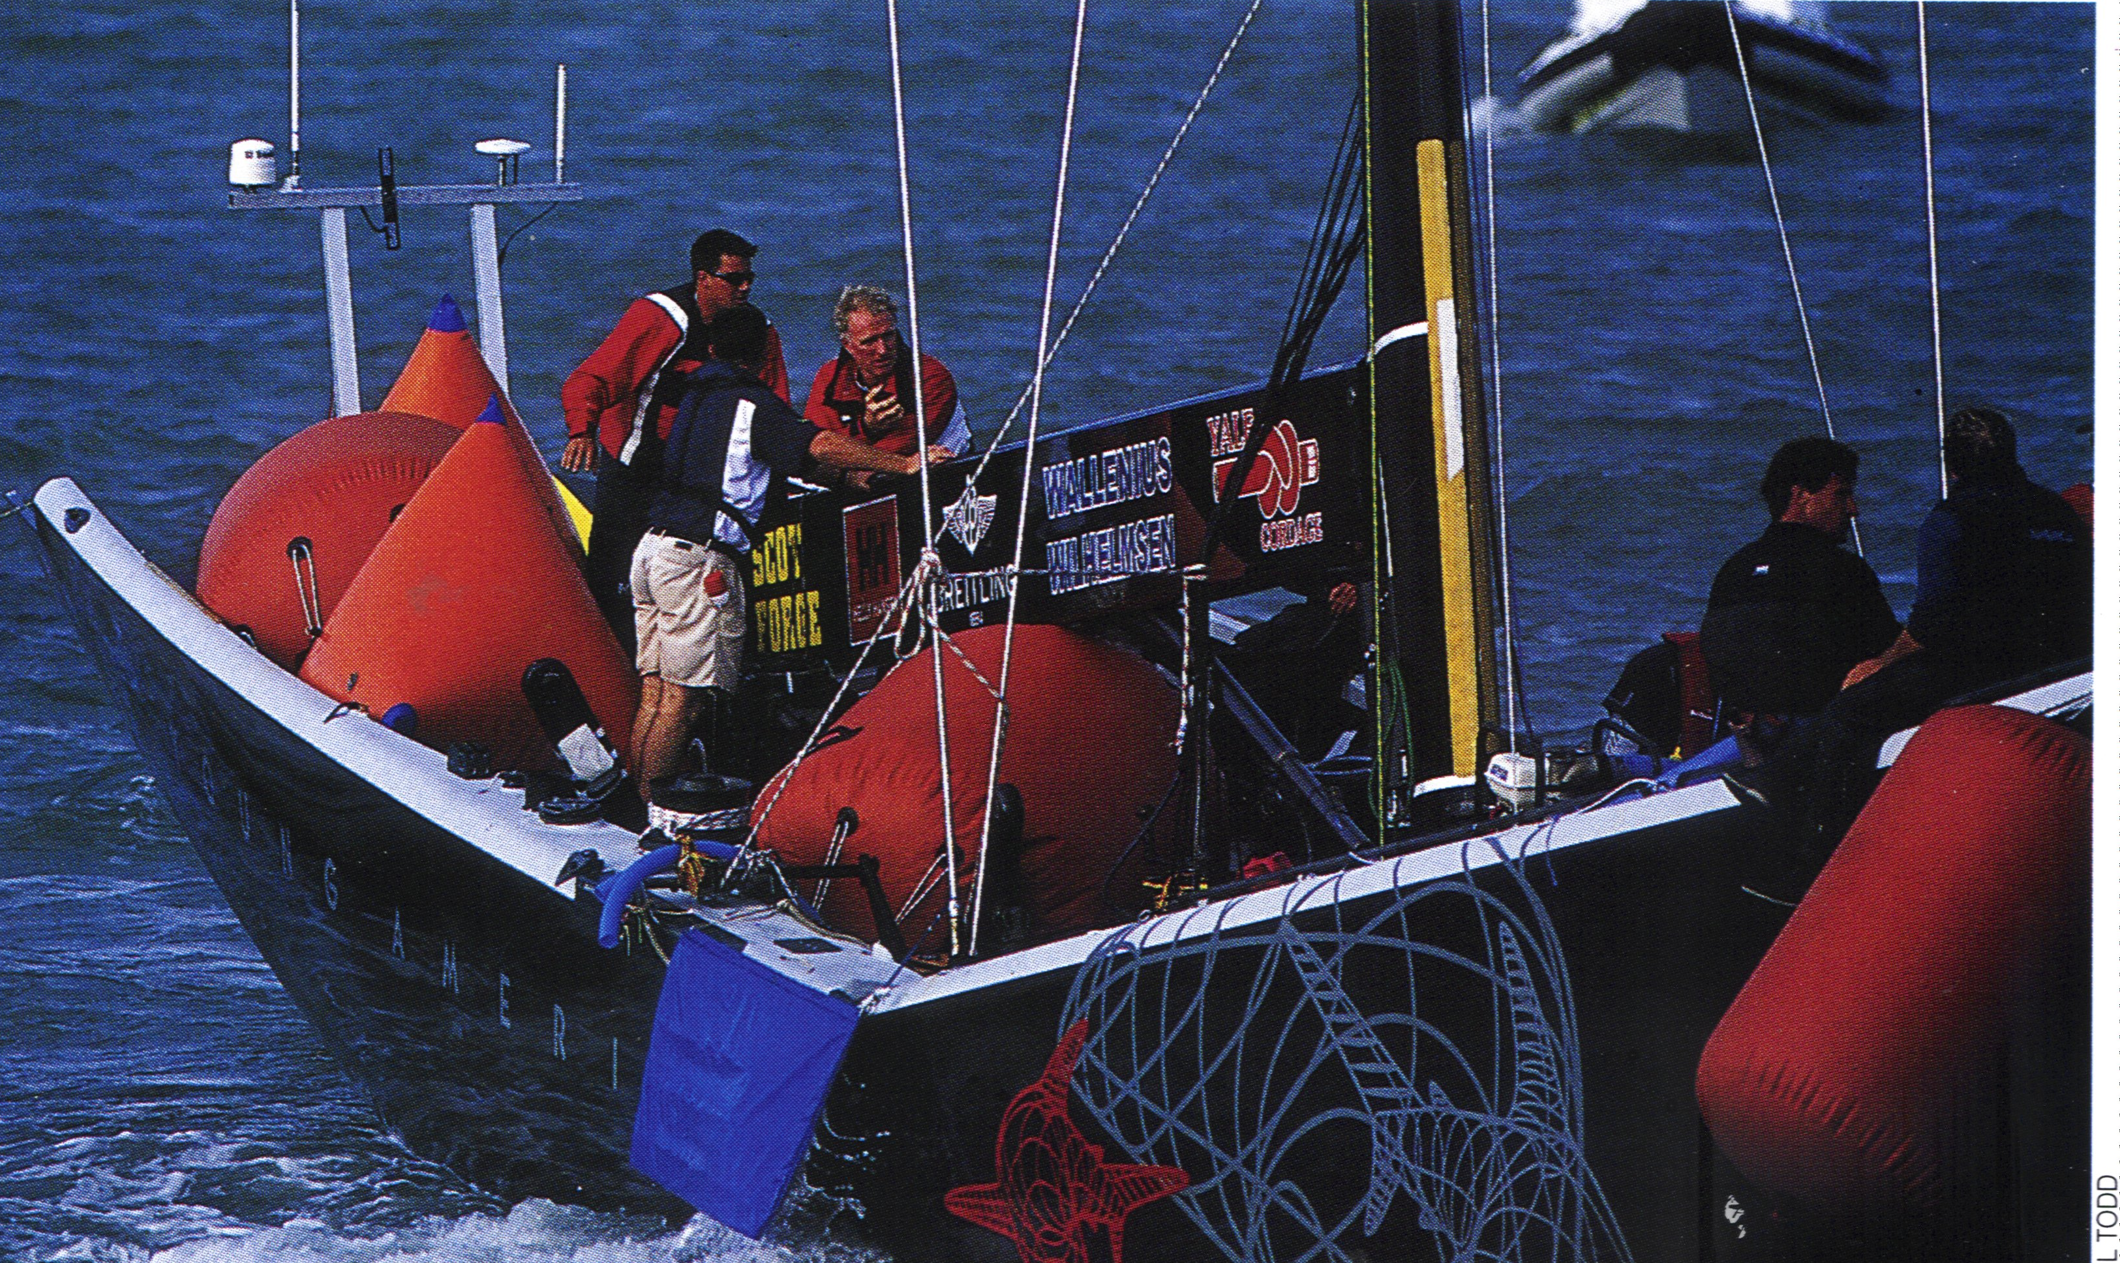
Who said … “It Doesn’t need Testing”
Broken Deck and topsides damage due to unbonded skin to core sandwich construction
The correct Inspection was not carried out – a miserable failure

Slide 3
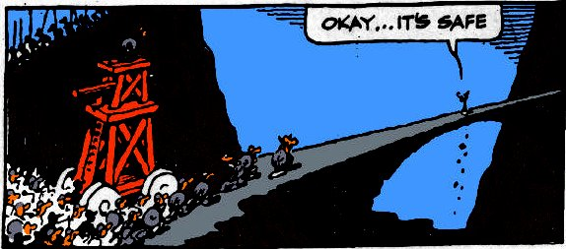

Correct Testing is Needed
Will it work
Will it continue to work
But not always correctly !!!!!!!
Correct testing methods are required – matching the inspection to the material and defects

Slide 4
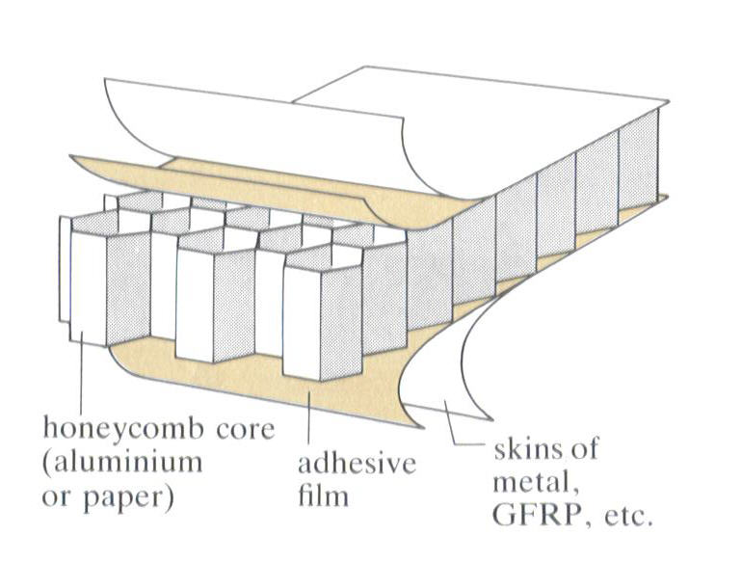
Motivation
GFK and CFK have a long history and become the norm for the modern yacht
sandwich constructions have seen a dramatic increase in their use
anti-corrosion, reduction in roll characteristics, reduced fuel consumption are only e few advantages
Materials and designs have transferred from aerospace domain
Sandwich constructions and composites developed for aerospace are now well established in the marine world
However Aerospace requires detailed and thorough inspections of all parts,
during manufacture and at regular servicing, under strict regimes for all parts
This inspection regime has now fully transferred to marine applications

Slide 5
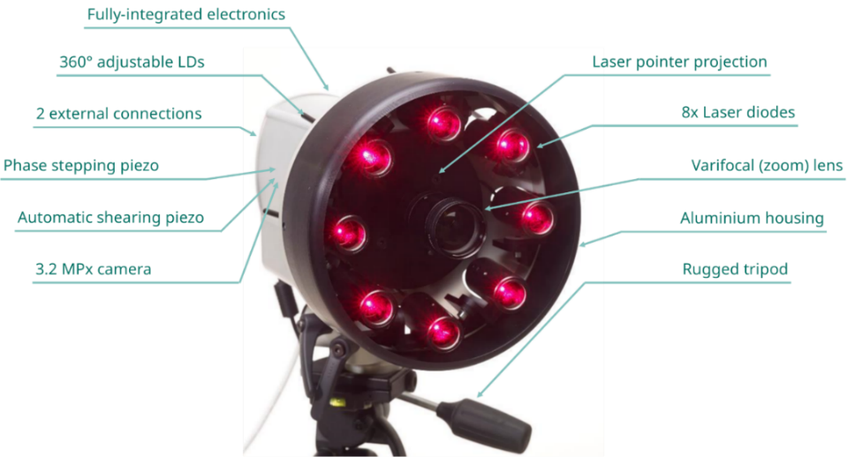
Shearography Principle
Laser Shearography (LS) is an optical, Non-Destructive Testing method based on the principle of laser-speckle-pattern interferometry.
A LS system consists of a measurement sensor together with an excitation system (i.e. thermal, vacuum or mechanical loading)
A “FlawExplorer” sensor consists of
    a divergent laser source illumination → information source
    a CMOS camera → recording medium,
    a shearing piezo & beam splitter → measurement sensitivity,
    a phase-shifter → minimize measurements from environmental noise,
    a SW imaging algorithm → advanced and post-processing of time-resolved images.

Slide 6
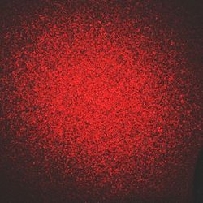
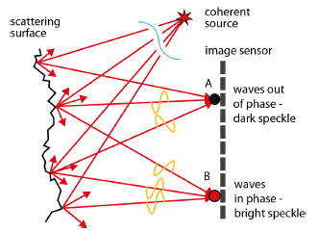
Shearography Principle
When a monochromatic & coherent laser light is projected on a rough surface, the surface microstructure causes the light source to scatter forming a unique (like a thumb-print) stochastic speckle pattern.
The reflecting waves from the object surface reach the imaging sensor in different phases, due to differences in their respective travel paths and also a degree of separation by the internal beam splitter.
This effect is known as shearing interferometry.
Source: https://en.wikipedia.org/wiki/Speckle_pattern
Source: https://physics.stackexchange.com/questions/280275/how-subjective-laser-speckle-pattern-is-formed

Slide 7
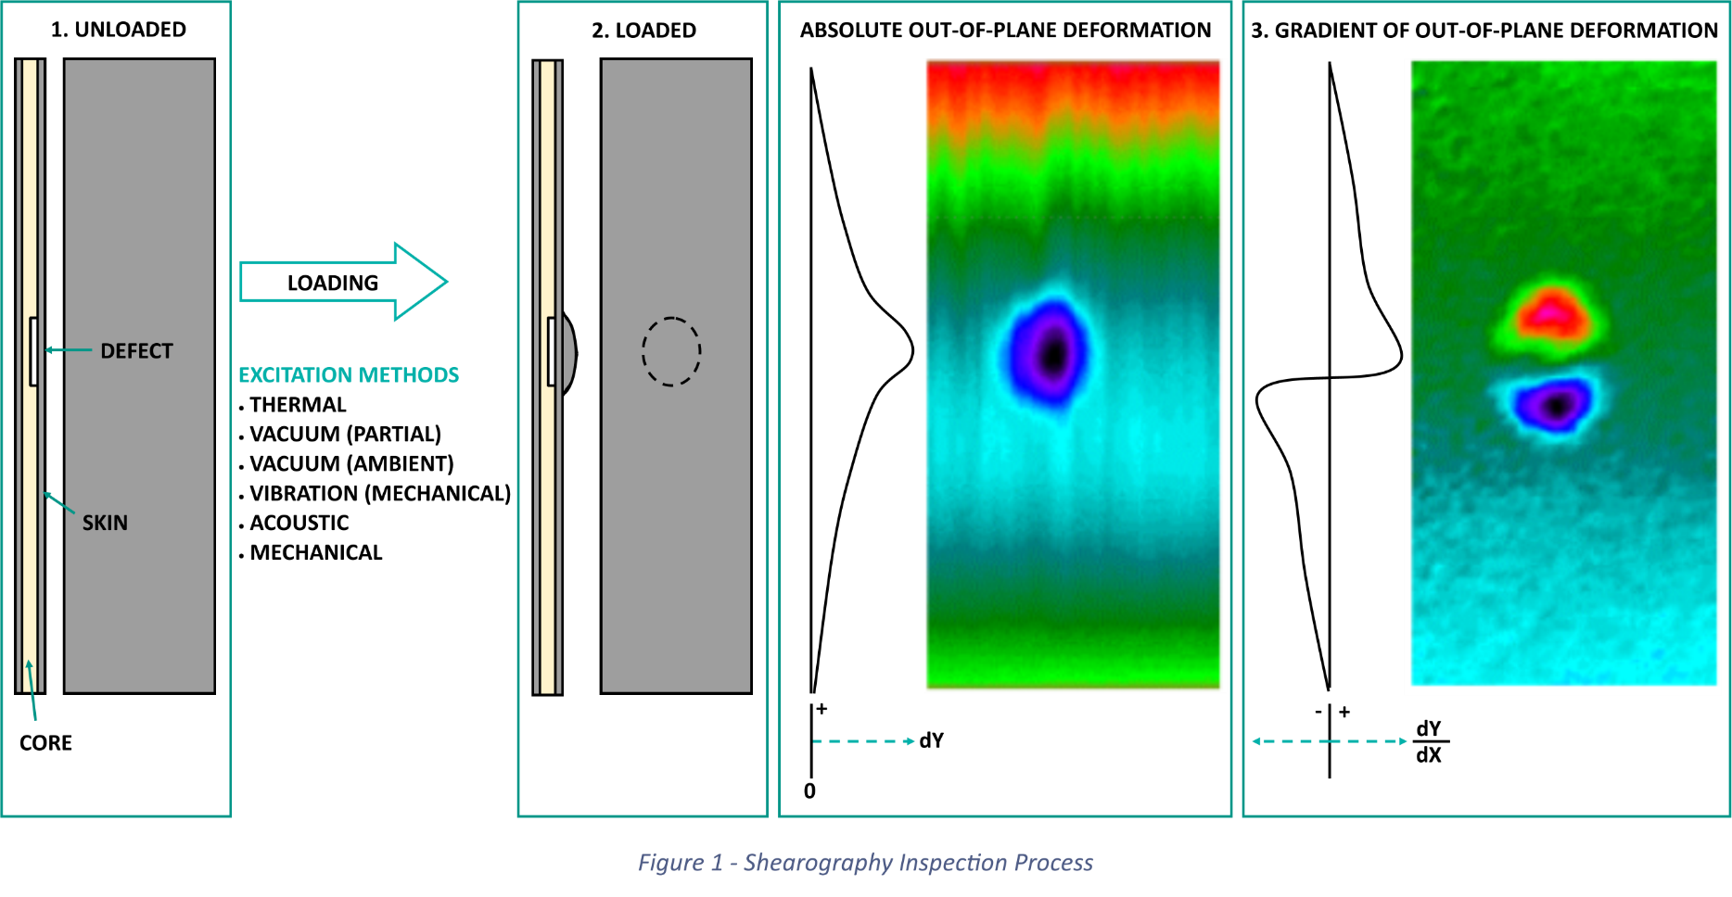
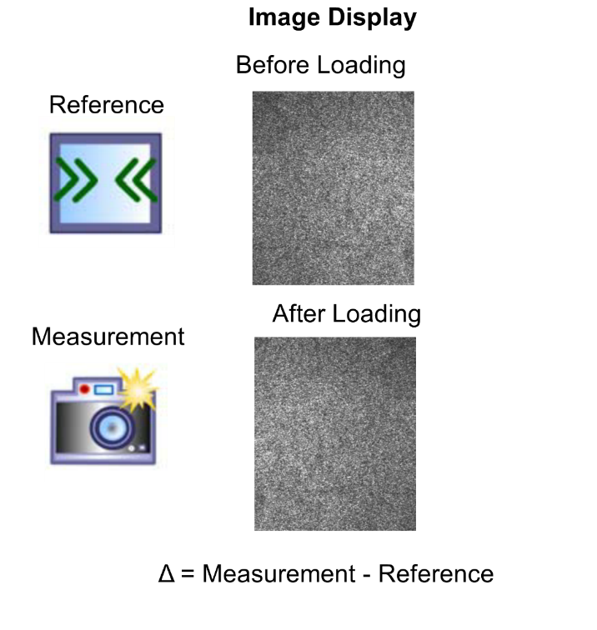
Shearography Principle
When a load or stress is applied to a sample, the surface above a defect will deform comparatively more than the parent material. This is because isolated defects cause a localized weakness in the structure.
the surface shape changes when the object is loaded
This leads to a change of the speckle pattern also
Laser Shearography simply measures the changing of speckle pattern (Δ) via image subtraction between two loading states.
this is a visualization of how a material responds to the applied load.
LS only observes the surface of the structure and does not penetrate the sample itself.
Defects beneath the surface are located by the manner in which they affect the surface (bending) strain field.

Slide 8
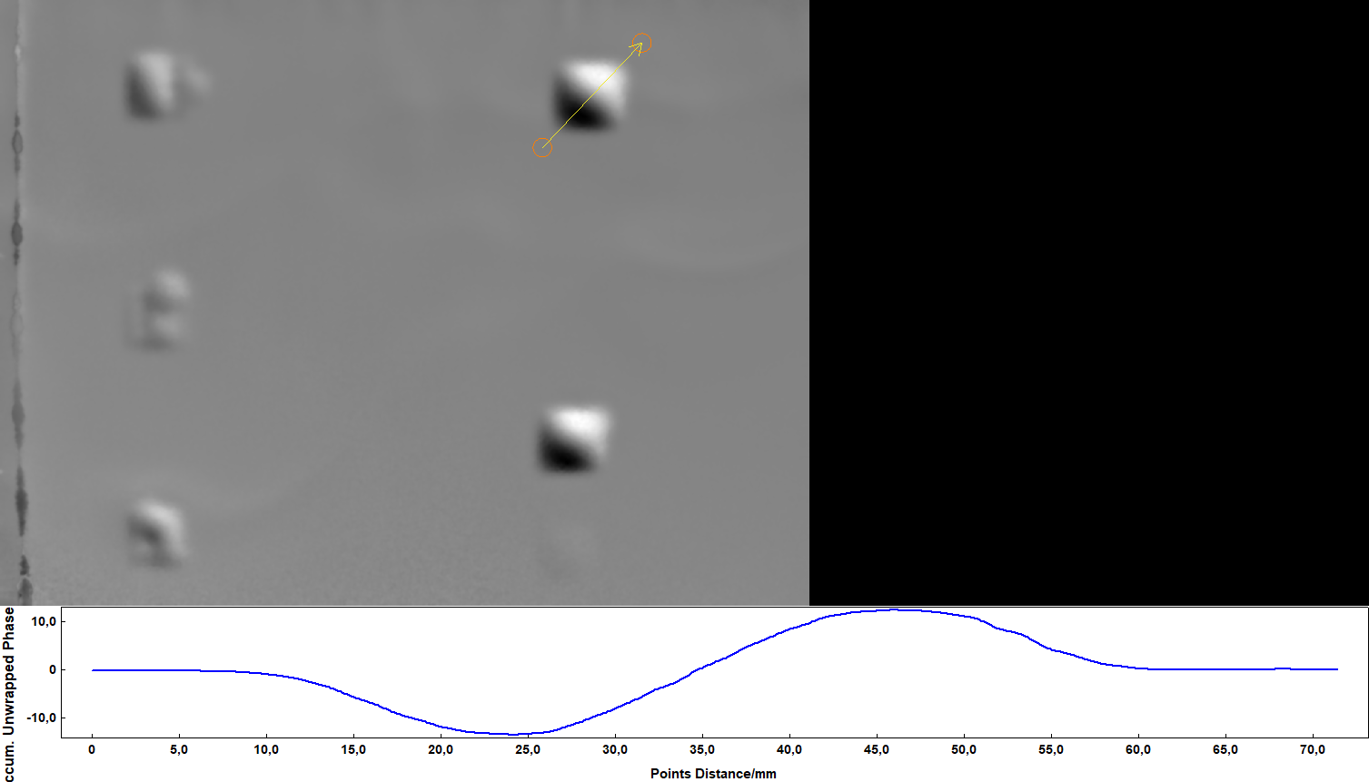
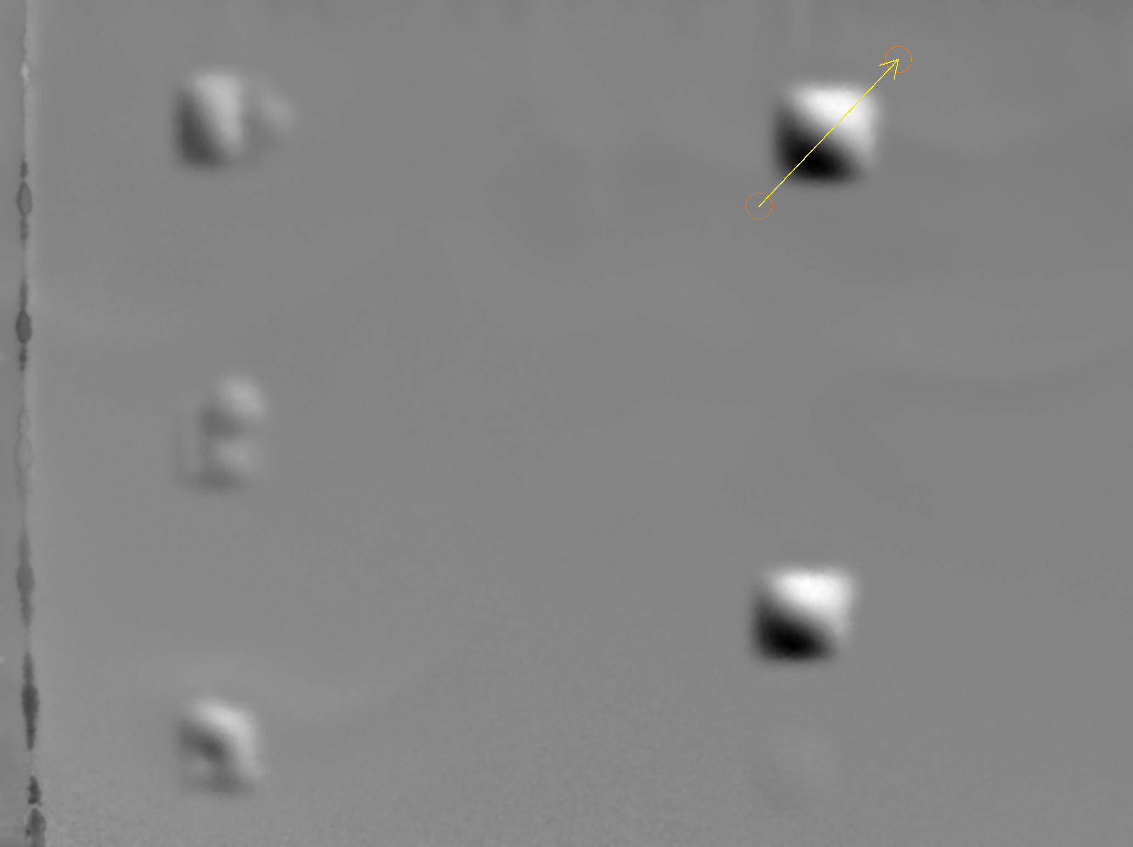
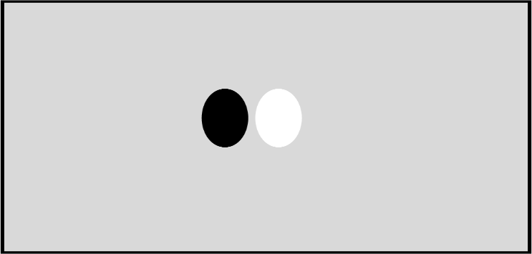
Shearography Principle
Shearogram
(Phase Map)
4+4 (Wrapped) Phase Display
Measurements taken before and after a change in load are visualized in a 2D shearogram (also known as a Phase Map).
The presence of discontinuities can be identified through localized changes in the rate-of-change (gradient) of the out-of-plane deformation - identifiable as black & white fringes.
A phase map is computed through the acquisition of multiple imaging steps
The phase map generates a temporal, filtered-image, desensitized from environmental noise.
As such, LS yields a high signal-to-noise (SNR) ratio making the presence of defects vivid → low false calls.
Butterfly Pattern
(Consisting of Fringes)

Slide 9
Defect Detectability
The efficiency of Laser Shearography depends on the application and also the ability of the excitation technqiue to generate bending strain to the test object.
Laser Shearography is one of the only NDT technique that can effectively detect
    Node Bond Splits in Honeycombs,
    Ply Wrinkling in Laminates (& Overwraps) and
    Kissing Bonds
→ these defects all require active stressing in order to be detected.
Laser Shearography NDT Applications
Honeycombs
Sandwiches
Laminates (Overwraps)
Compounds/
Ceramics
Spray Foams/ Sealants
Bondings/
Coatings

Slide 10
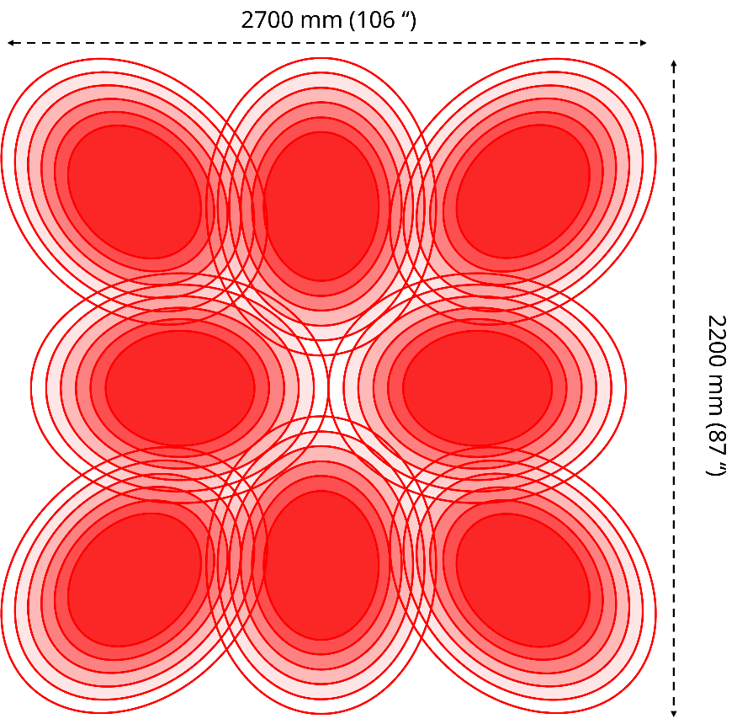
Laser Shearography – A fast NDT Technique
Laser Shearography has one of the highest inspection rates compared to any NDT method, specifically becasue it utilizes a large Field-of-View (FoV) from the use of multiple laser diodes.
The FlawExplorer with 8 laser diodes, can achieve an illumination area of up to 2.7 m (H) x 2.2 m (V),
6 m² can be covered per sibngle inspection.
Coupled with short loading time application, an inspection rate of multiple m² can be achieved per minute! This allows faster and more economical NDT inspections.
Notes:
Higher inspection or throughput rates → Faster & therefore, more economical inspections
Shorter manufacturing times of components
Lower downtimes of aircraft during servicing
Why is this important?
Continued increase in the demand of new aircraft → Market
Prolonged service operational life of current aircraft → Operators

Slide 11
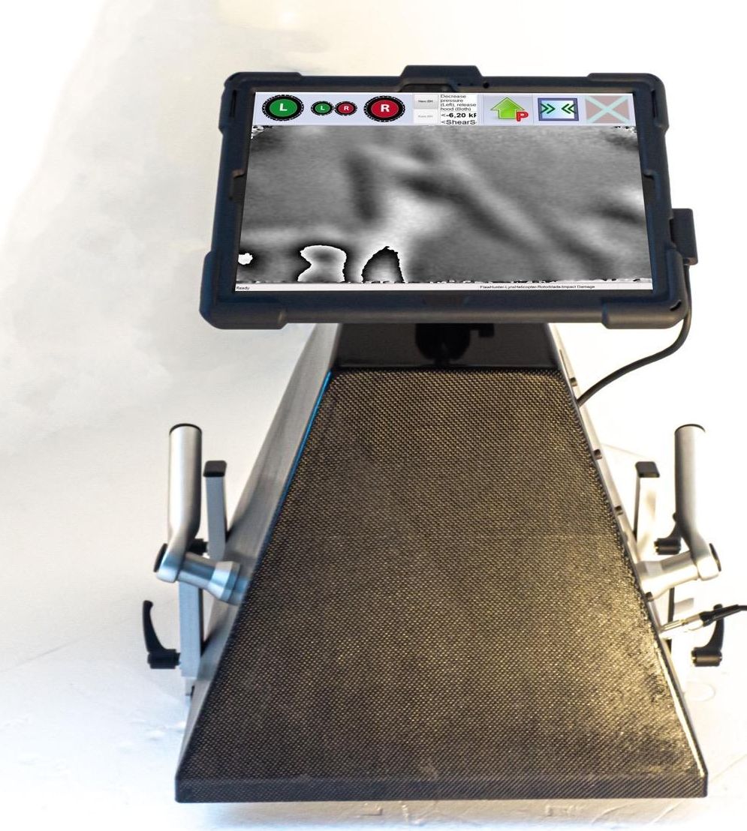
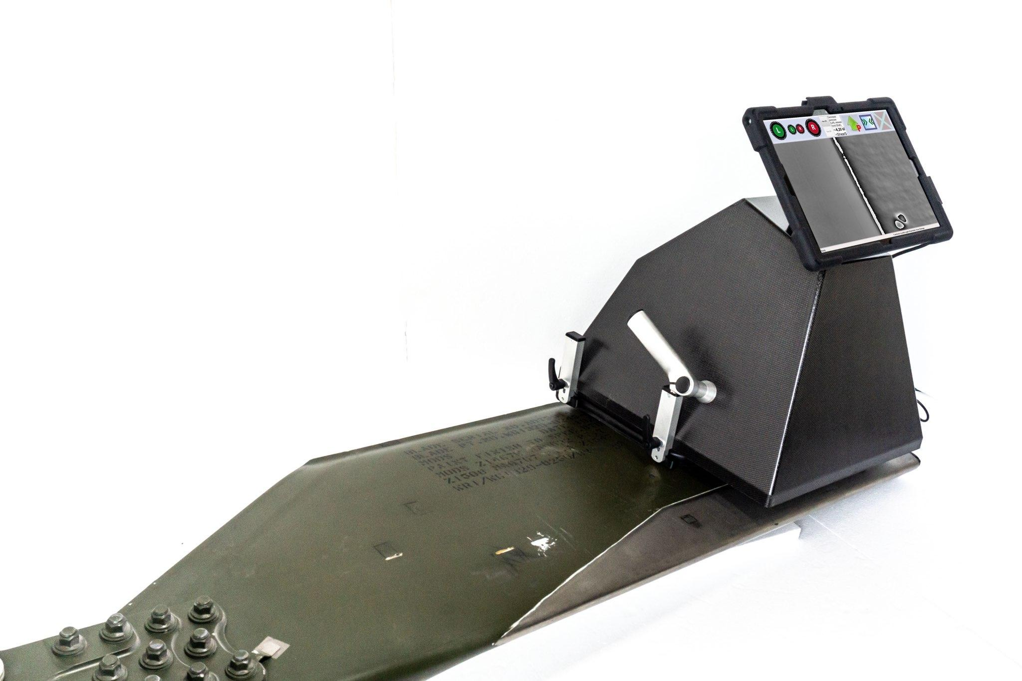
FlawExplorer & FlawHunter
8 units of low power laser diodes increase the area of coverage and gives great flexibility
Large FoV up to 6m²
Ergonomic handling
Contour following automatic locking feet
Lightweight but strong hood for in-field operation

Slide 12
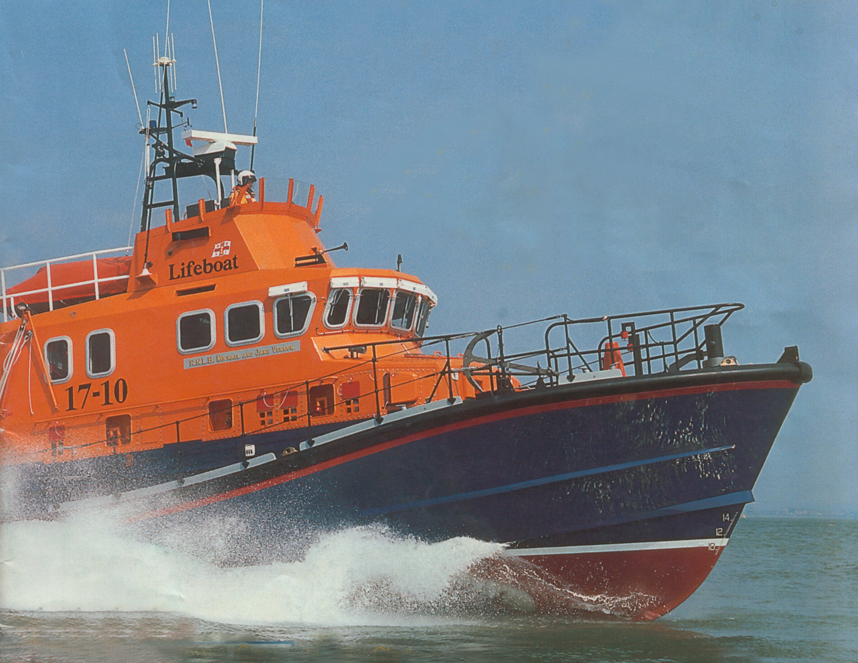
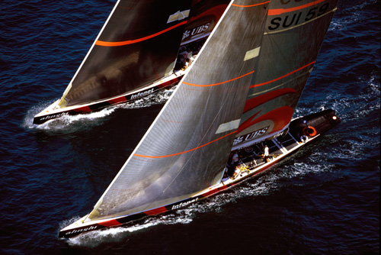
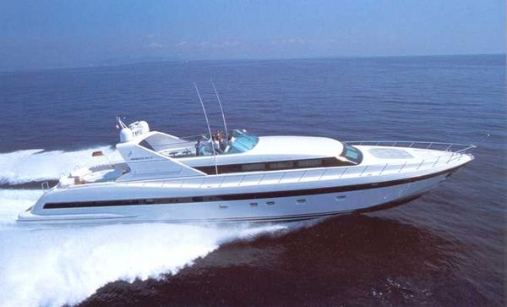
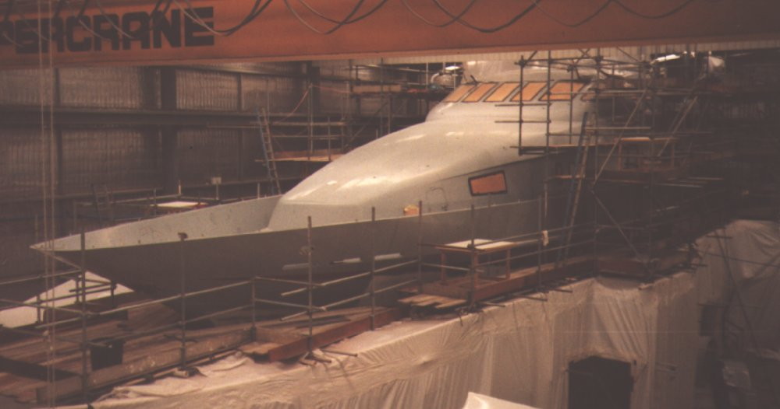
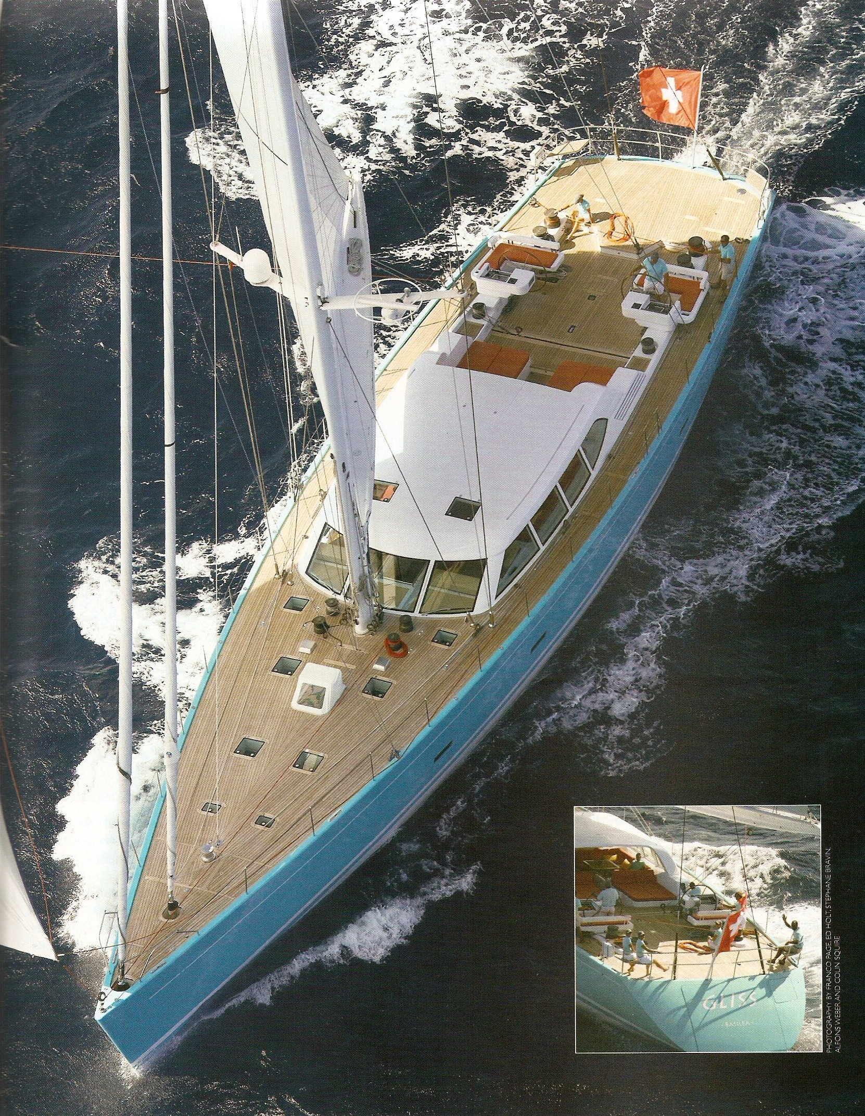
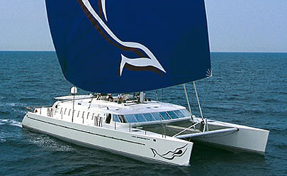
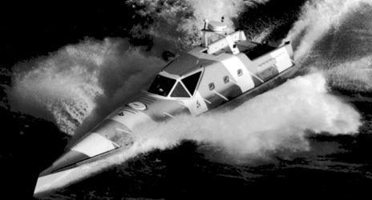
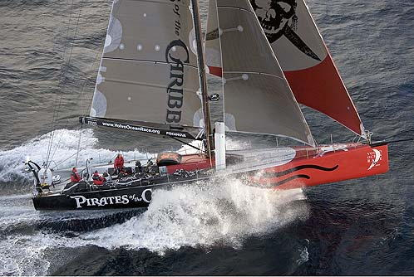
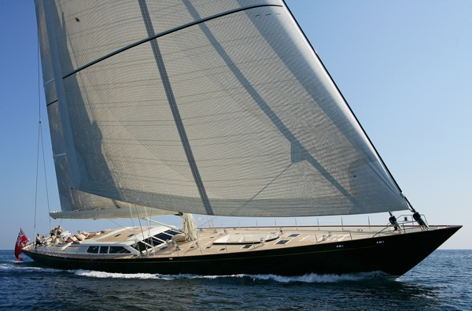
Laser Shearography used in the Marine Domain
Common feature of all these – Composite Sandwich Construction
All tested in production or in-service

Slide 13
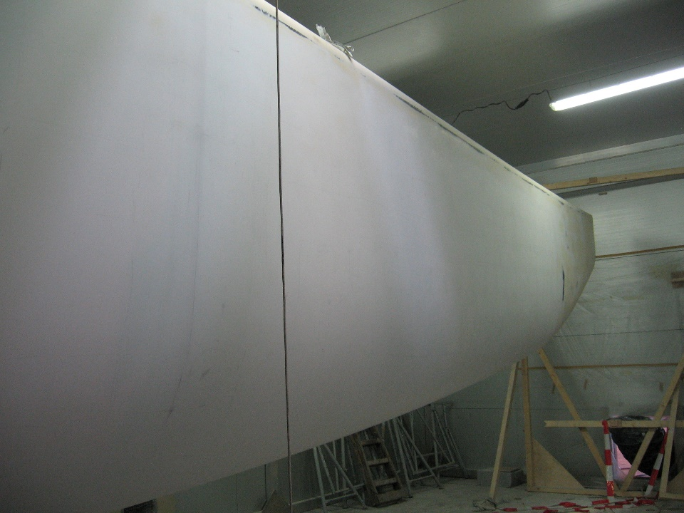
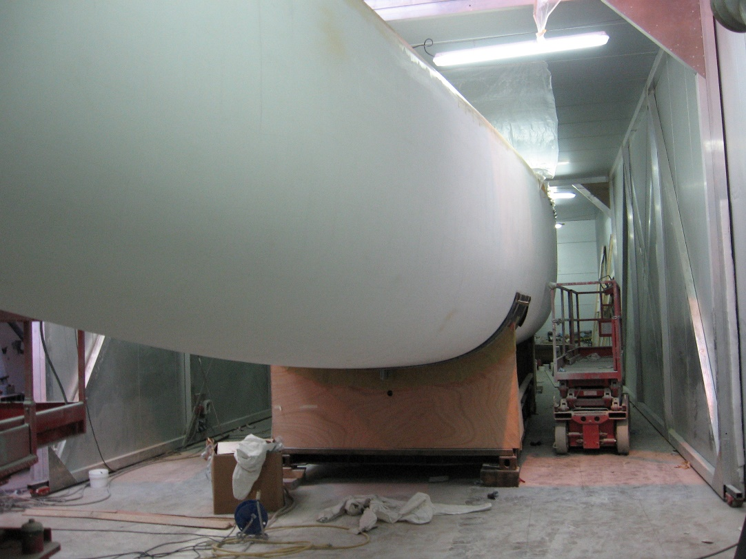
100% Coverage of Hull & Fore deck
Carbon fibre skins with
Nomex Core sandwich

Slide 14

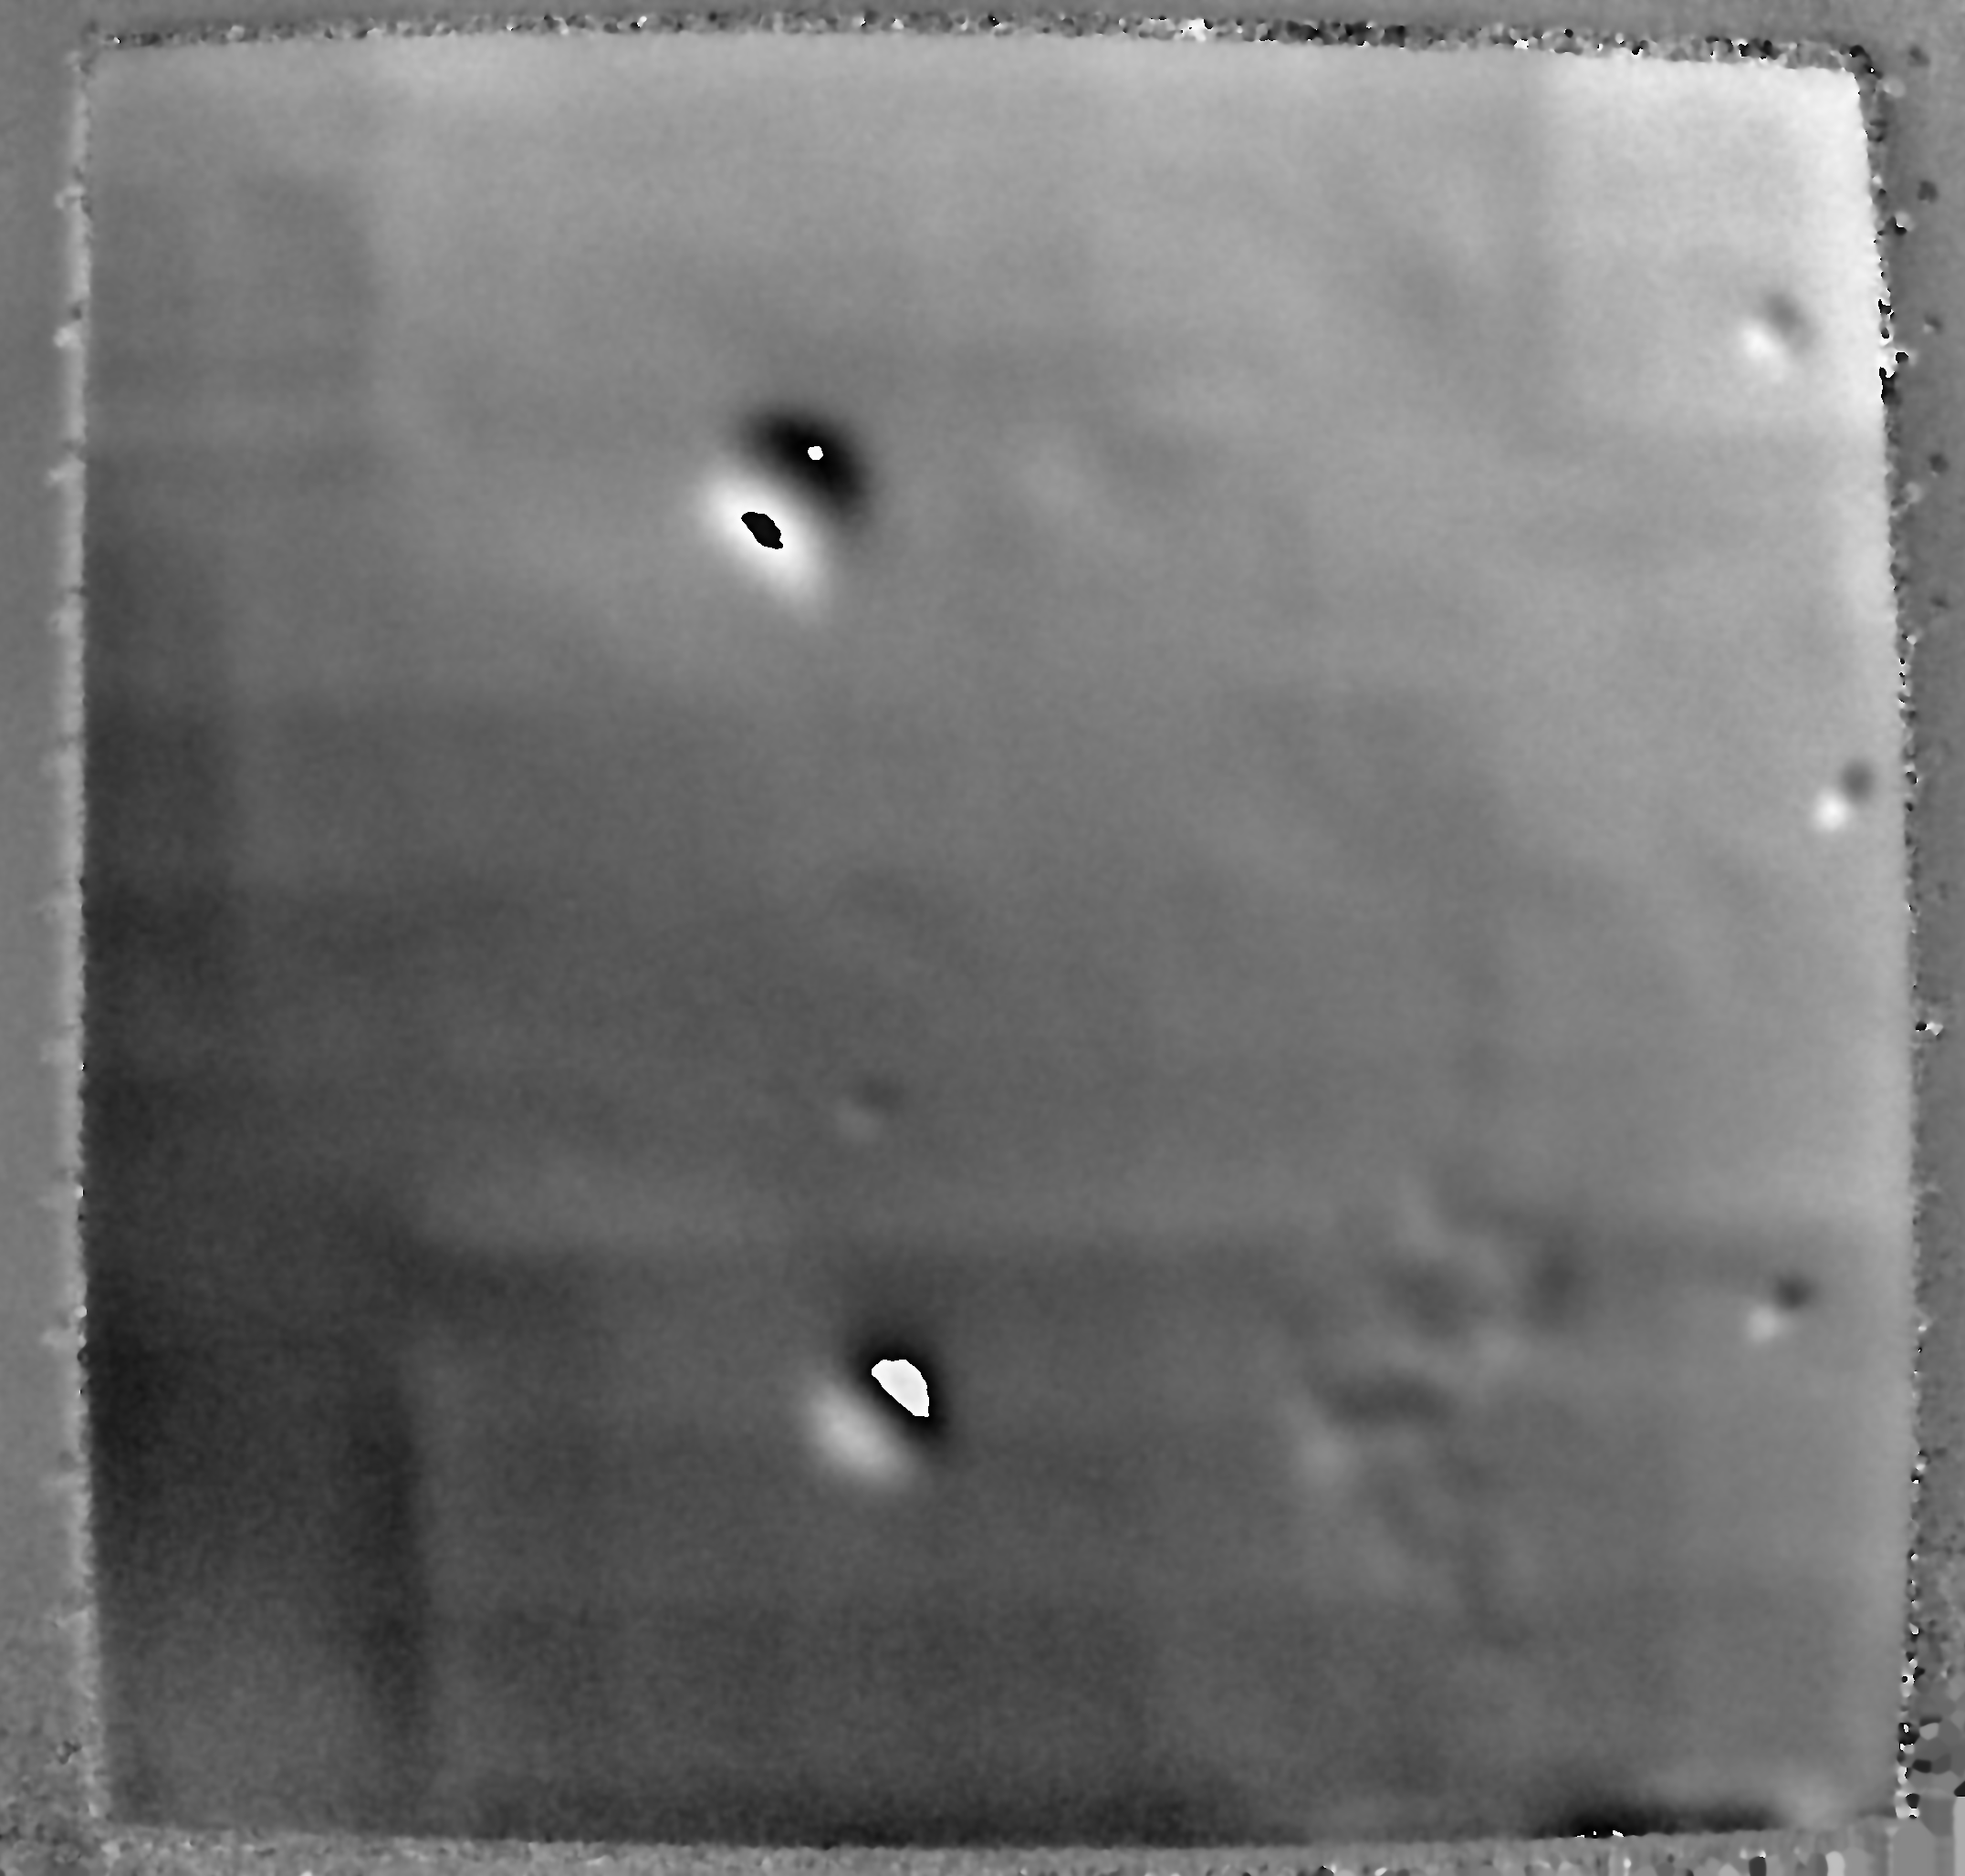
Excerpt of some results
Defects
No. of Defects | 6
A + B | Impact Damage (Crushed Core) or Disbond
C | Erosion Damage (Node Splits)
D | Disbond (within a Stiffened Structure)
E + F +G | Disbonding
D
A
E
G
C
F
B
20 kPa

Slide 15
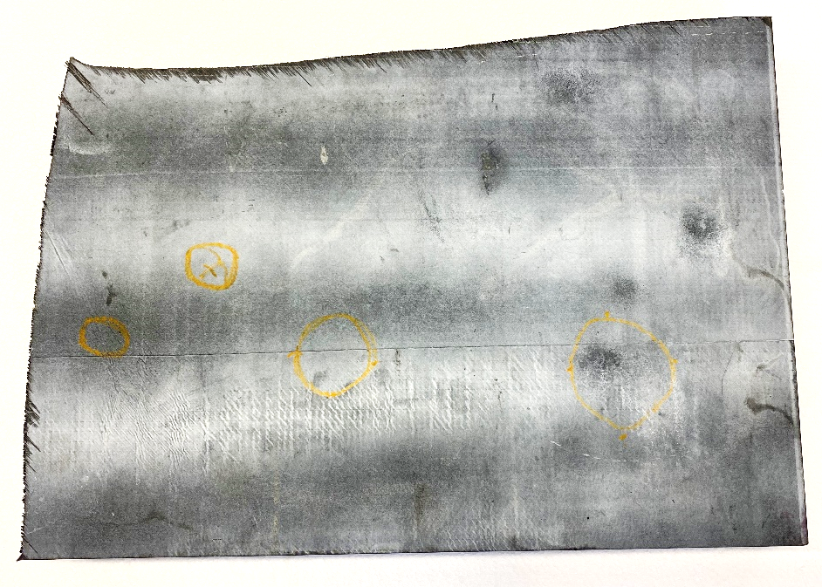
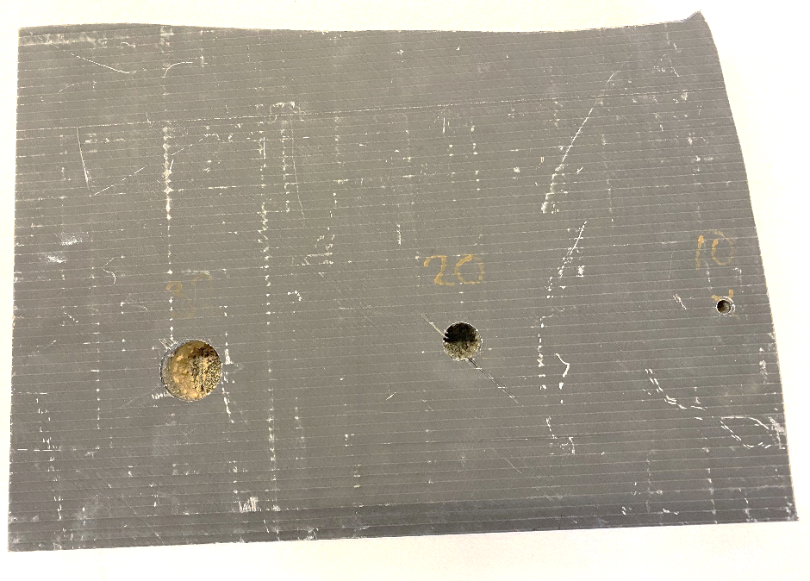
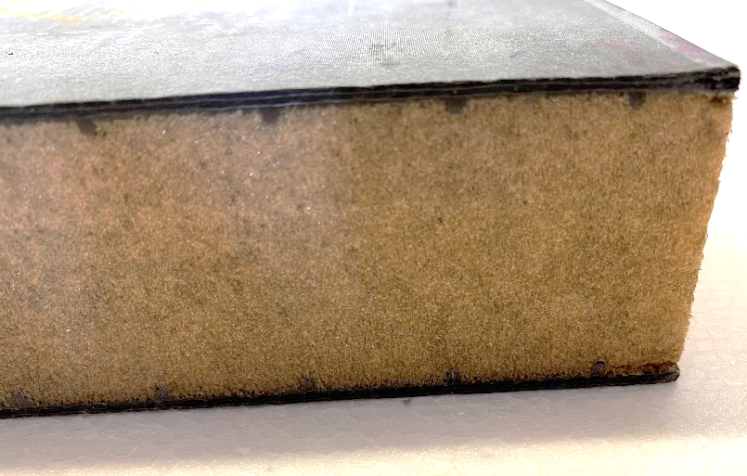
CFRP Laminate Skin / Foam-Core Sandwich
Object Description | Hull Yacht CFRP Laminate Skin / Foam-Core Sandwich
Construction | (Top) Laminate CFRP Skin → 2.5 mm (0,1 “) (Middle) Foam Core 40 mm (1.7 ’’) (Bottom) Laminate CFRP Skin → 2.5 mm (0,1 “)
Test Object Size | 30 cm x 42 cm x 4.5 cm (11.8 ’’ x 16.5 “ x 1.9 “)

Slide 16
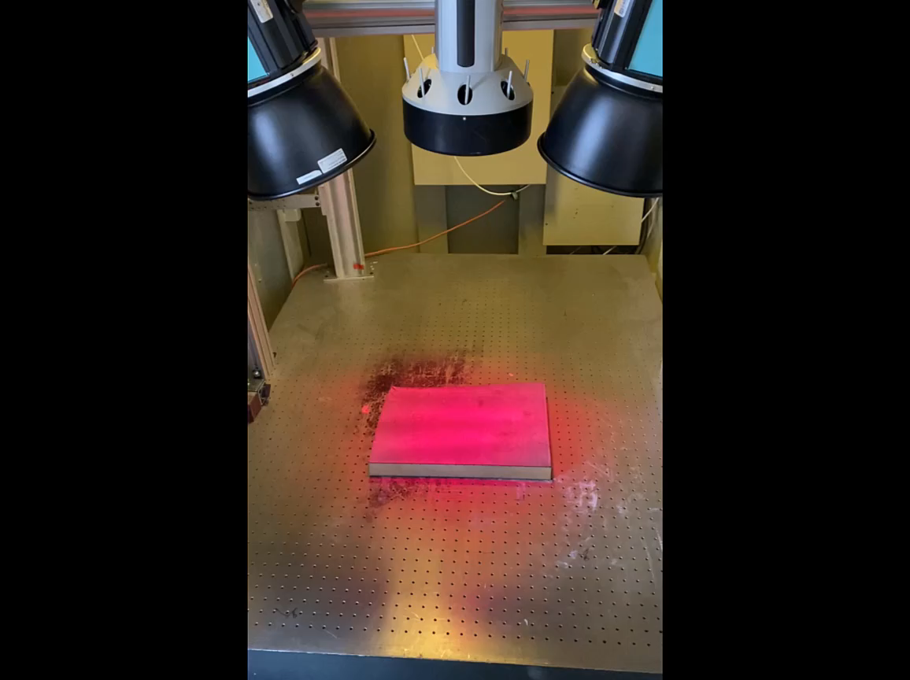
Measurement with FlawExplorer
Test Method | Thermal Excitation 2x 1.3 kW Halogen (Spot) Heat duration: 10 seconds Reference @ 15 seconds Snapshot Images @ 1 per sec. Shear: 5 mm @ 45° Distance: 700 mm (27.6 ‘’)
Display Properties | Phase Display LP: 3.0 Px HP: OFF Display Range: -π to +π
Field-of-View | 310 mm x 270 mm (12.2 ’’ x 10.6 ’’)
Duration of Inspection | 30 seconds
Inspection Rate | 0.17 m²/min (1.8 ft²/min)

Slide 17
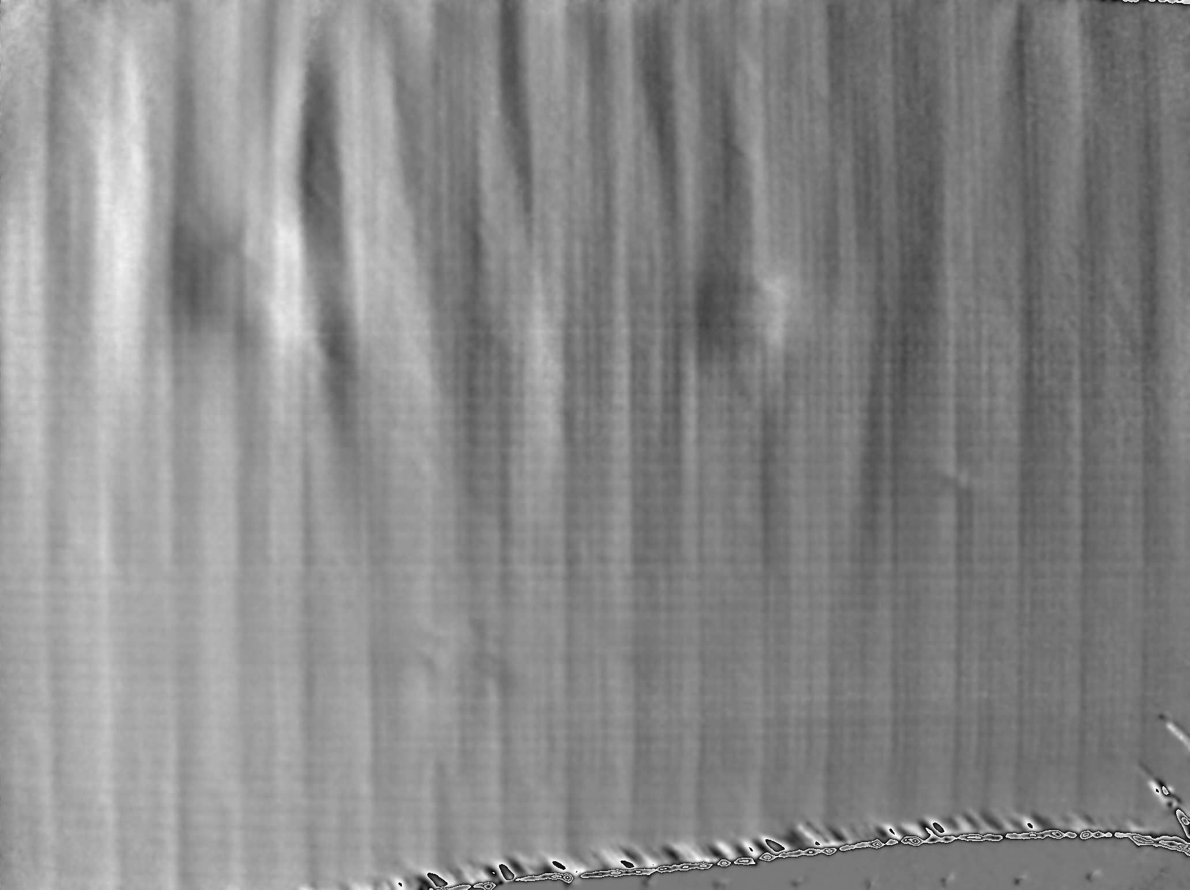
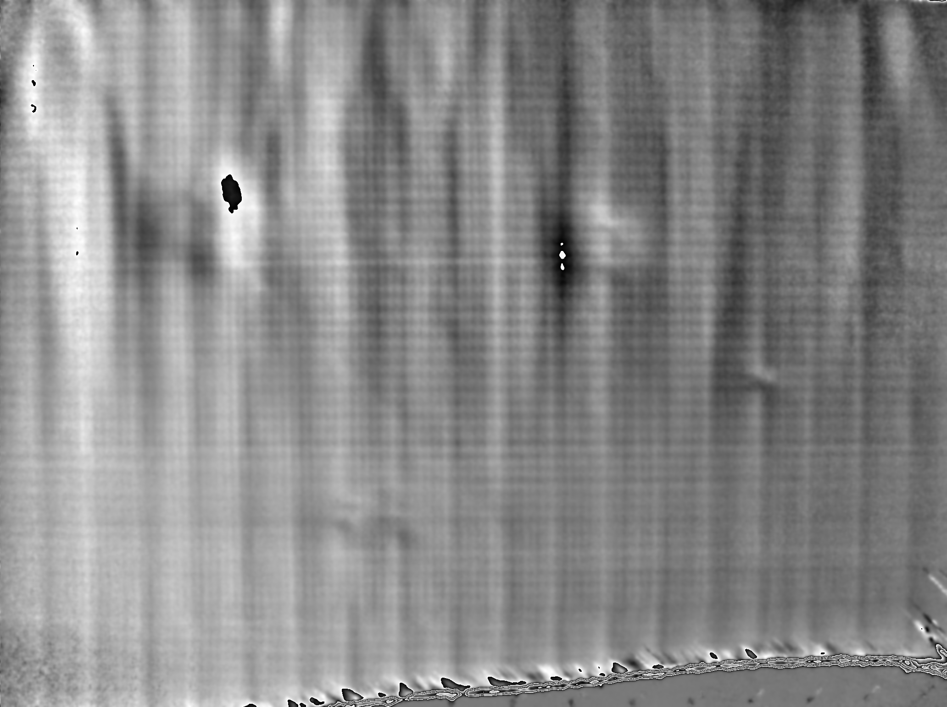
Typical Rsults
Test Method | Thermal Heat 10 s / REF @ 15 s / Snapshots @ every 1s to 30s
Shear Settings | 2.5 mm @ 45°
Display Properties | Accumulated Phase Display LP: 3.0 Px / HP: 0/ Display Range: Off / Transparency: 0%
Test Method | Thermal Heat 15 s / REF @ 10 s / Snapshots @ every 1s to 35s
Shear Settings | 5 mm @ 45°
Display Properties | Accumulated Phase Display LP: 3.0 Px / HP: 0/ Display Range: Off / Transparency: 0%

Slide 18
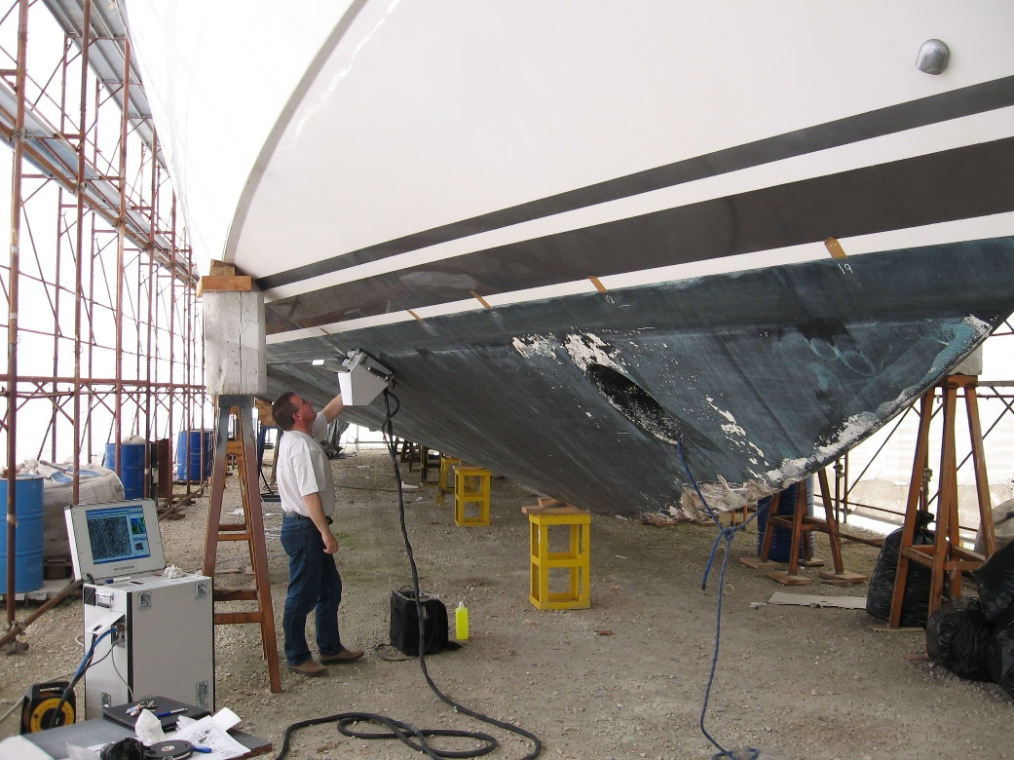
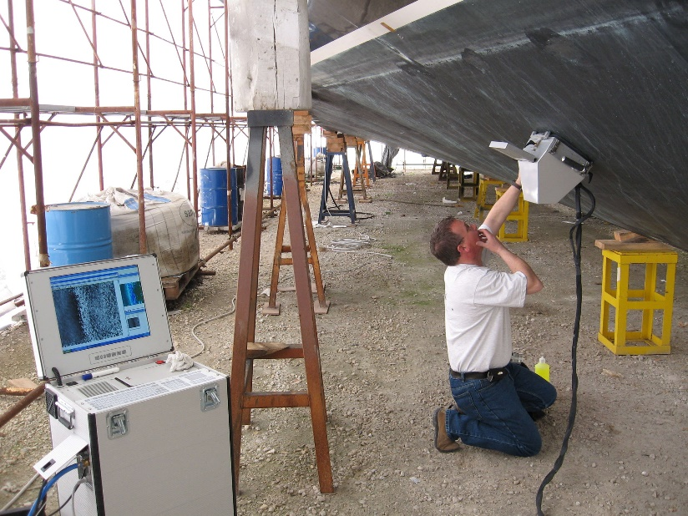
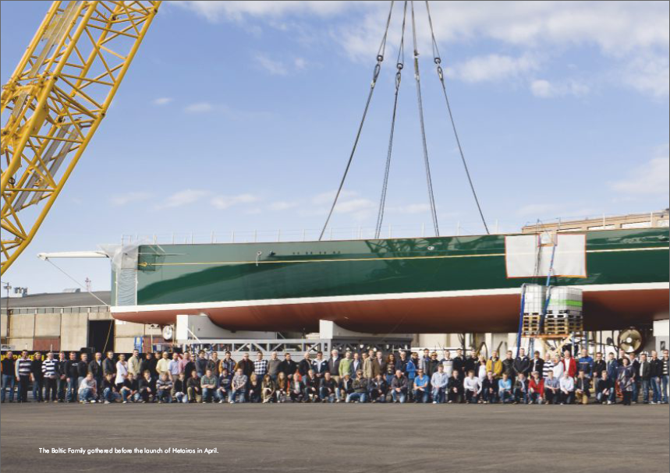
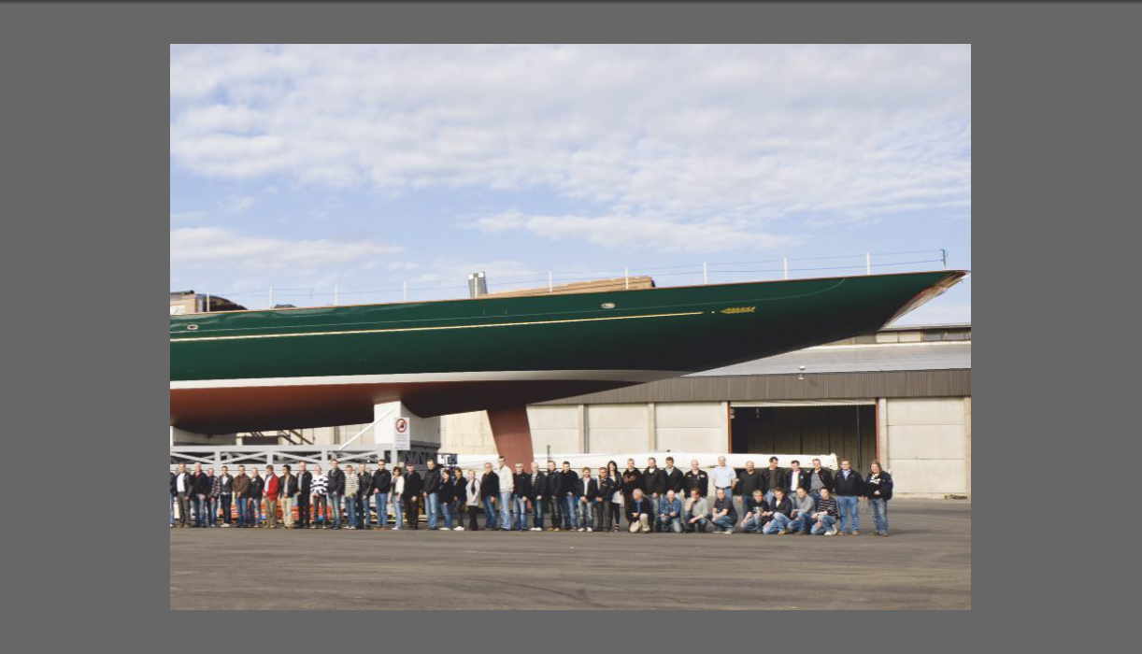
Large Area Inspection
100% Inspection of Hull, Decks, Superstructure and internal Bulkheads during production
Inspected using the Dantec Q810 Vacuum Hood
Inspection for disbonds after being dropped on Quayside in South Africa – No defects and all Bulkheads Attached

Slide 19
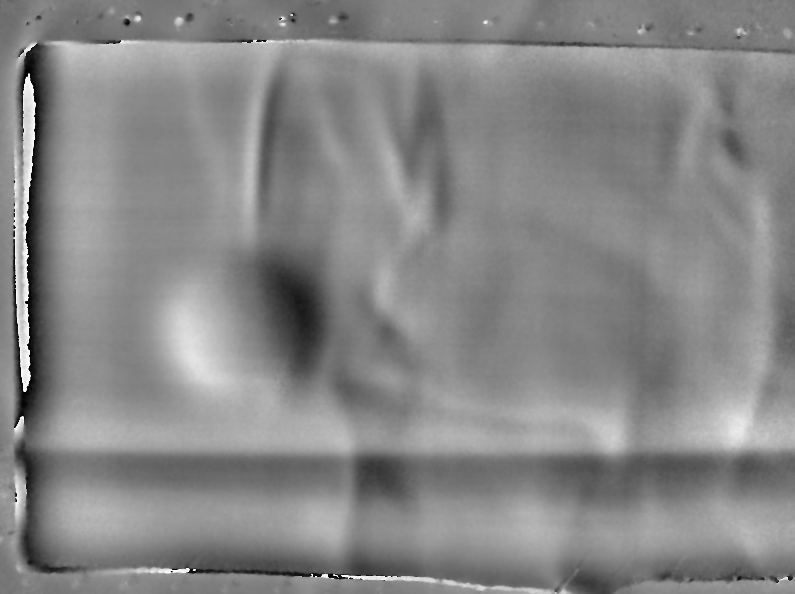
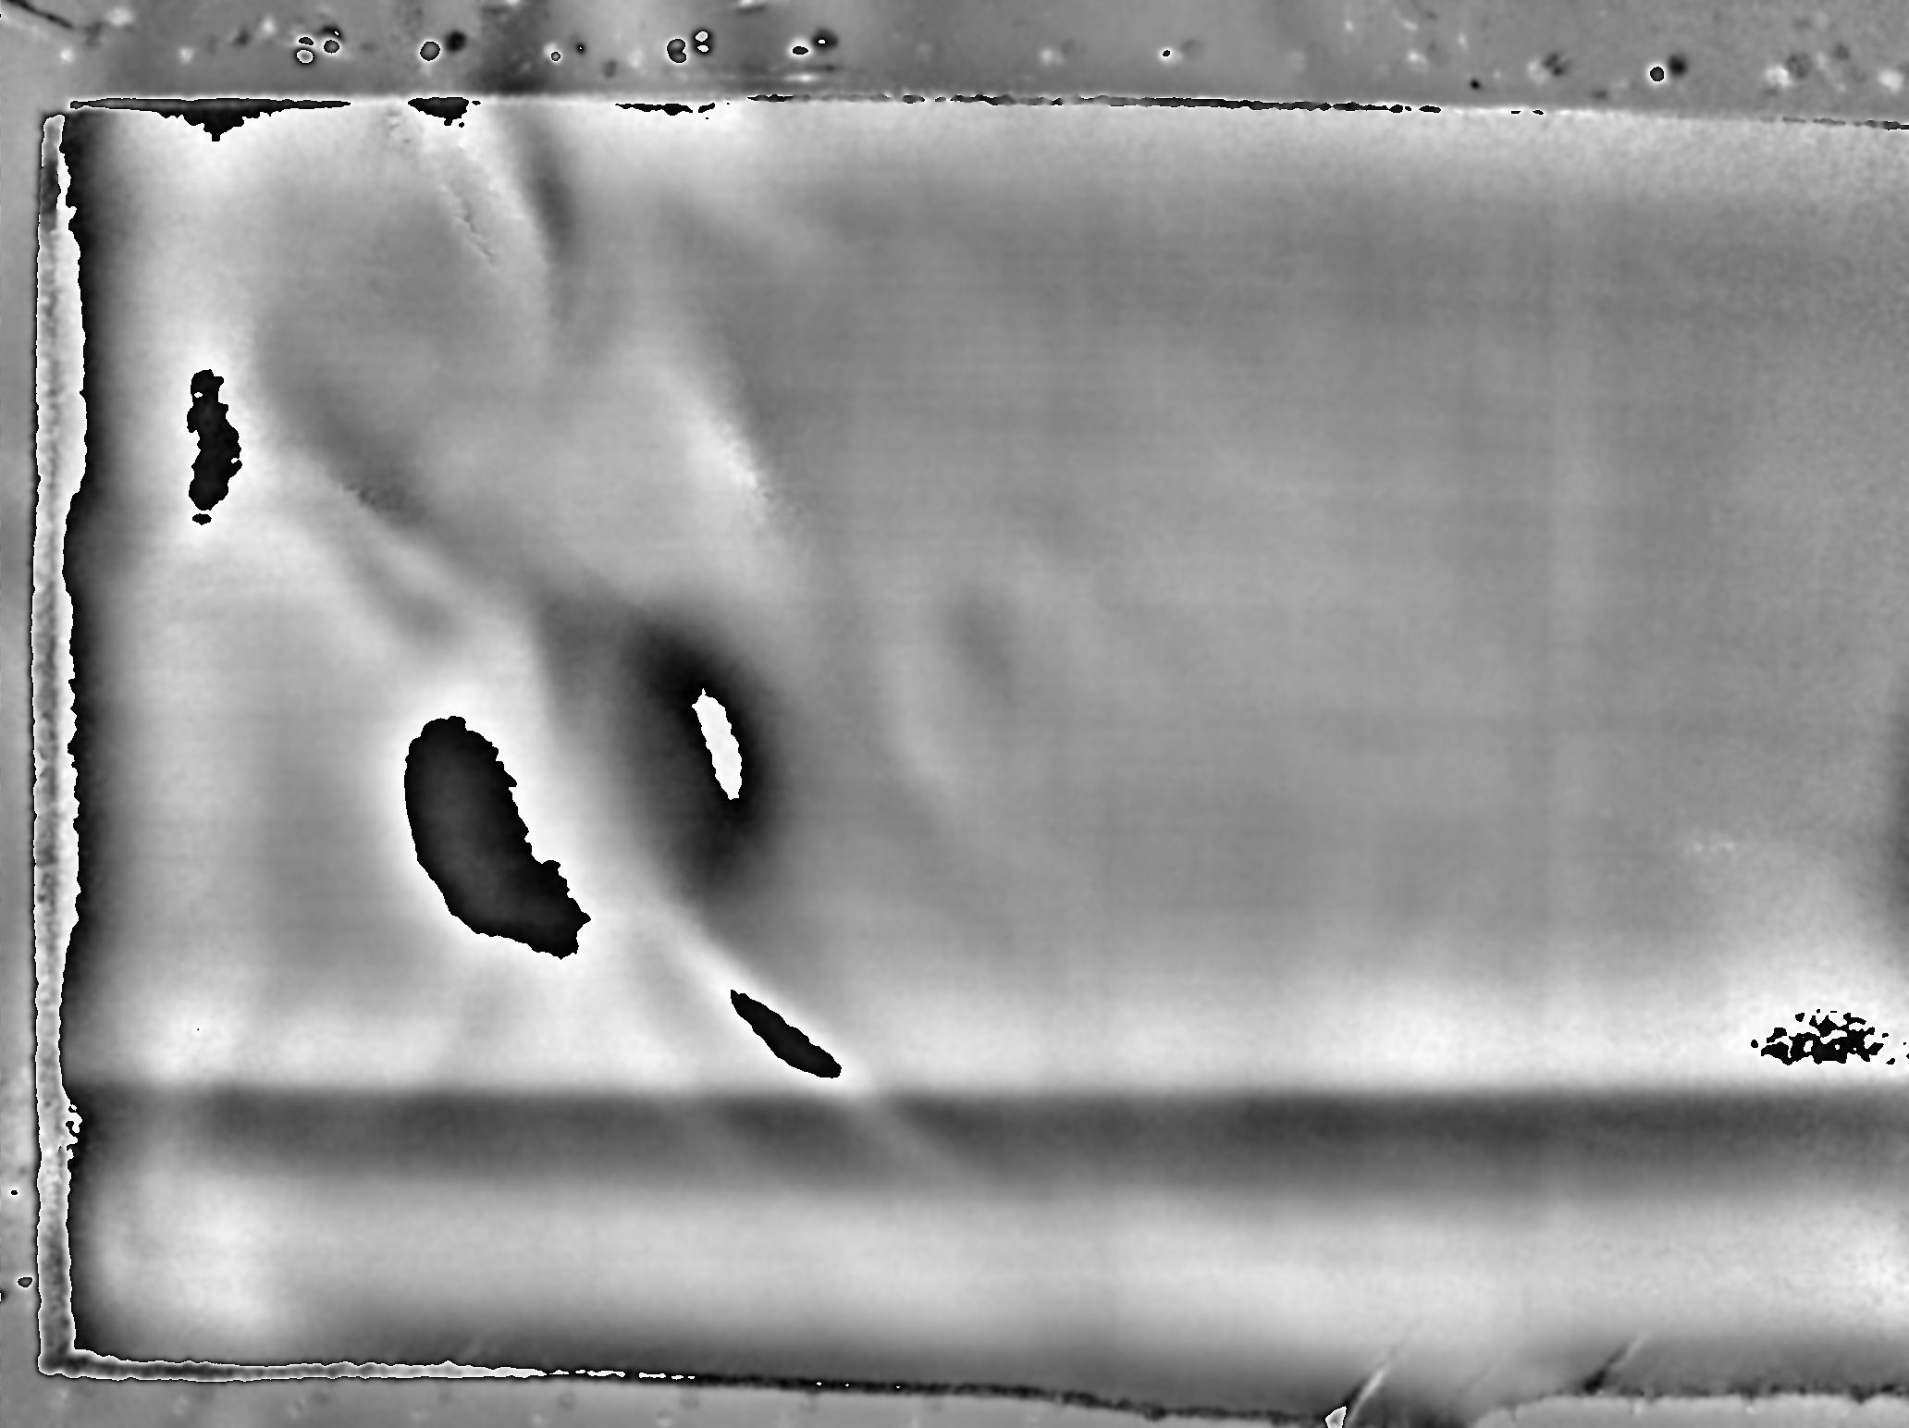
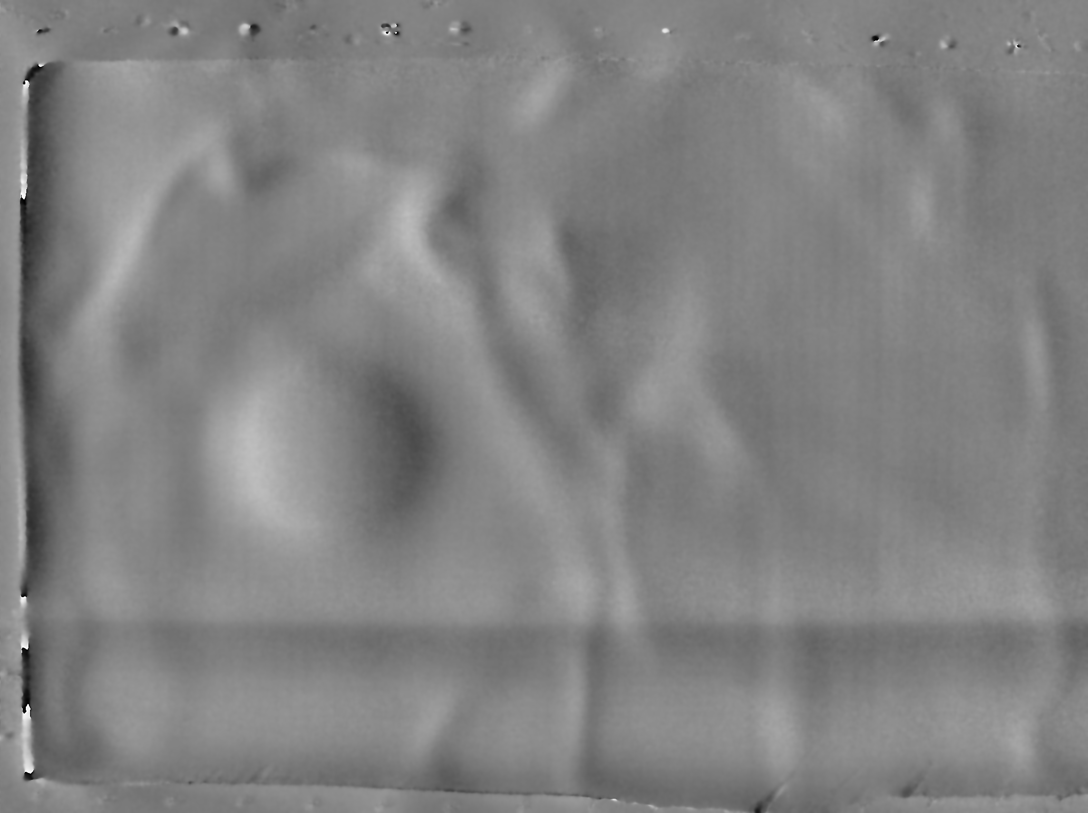
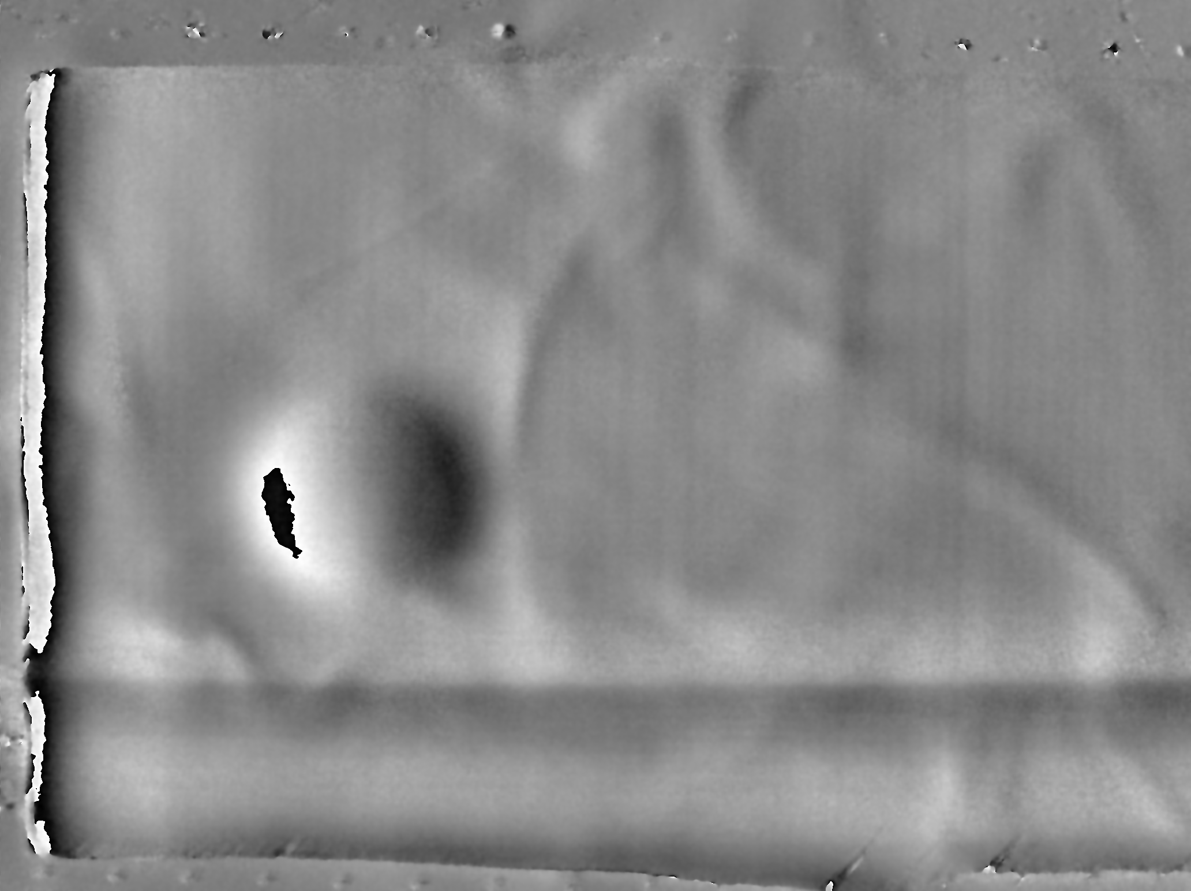
Large Area Inspection – Result Examples
Shear: 5 mm @ 45°
ΔP: 5 kPa
Shear: 5 mm @ 45°
ΔP: 10 kPa
Test Method | Vacuum (Ambient)
Display Properties | Accumulated Phase Display LP: 3.0 Px / HP: Off / Display Range: Off / Transparency: 0%
Field-of-View | 340 mm x 250 mm (13.4 ’’ x 9.8 ’’)
Duration of Inspection | 10 seconds*
Inspection Rate | 0.5 m²/min (5.5 ft²/min)
Shear: 2.5 mm @ 45°
ΔP: 5 kPa
Shear: 2.5 mm @ 45°
ΔP: 10 kPa

Slide 20
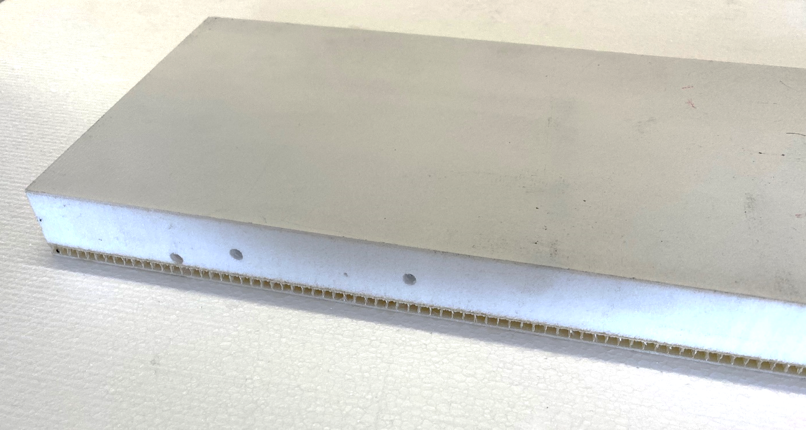
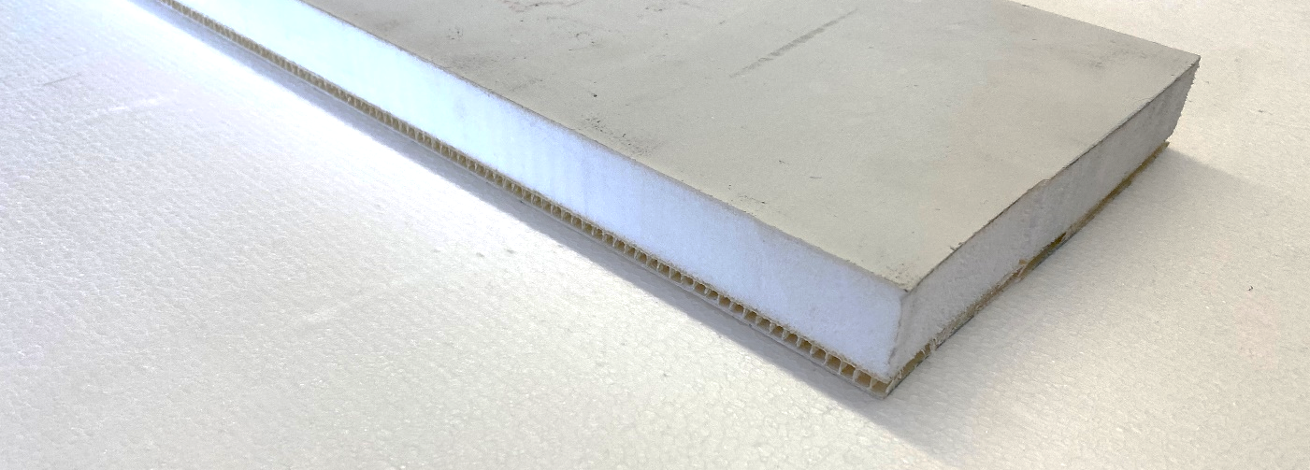
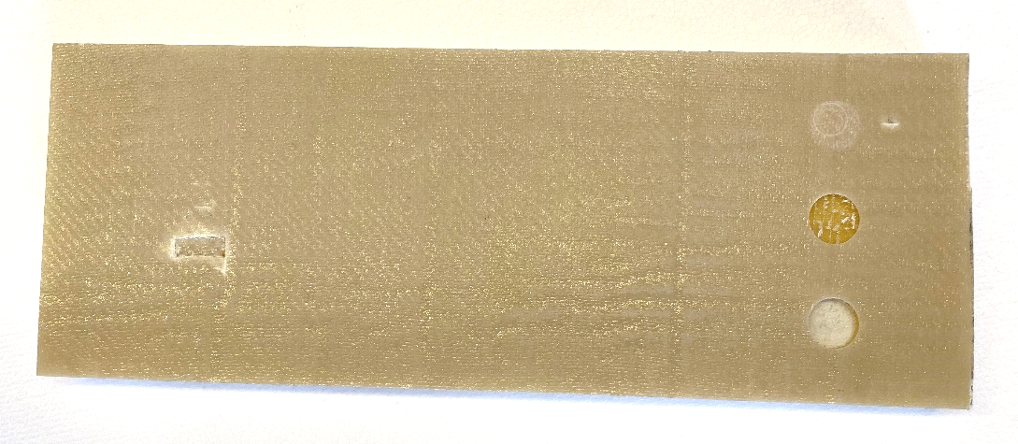
GFRP Lam. / Foam-Core / GFRP Integral Backing
Object Description | Hull Yacht GFRP Laminate Skin / Foam-Core Sandwich / GFRP Integral Stiffener Backing
Construction | (Top) Laminate GFRP Skin → 1 mm (0,04 “) (Middle) Foam Core Sandwich 24 mm (0.94 ’’) (Bottom) GFRP Integral Stiffener Backing → 5 mm (0.2 “)
Test Object Size | 45 cm x 17 cm x 3 cm (17.7 ’’ x 6.7 “ x 1.2 “)

Slide 21
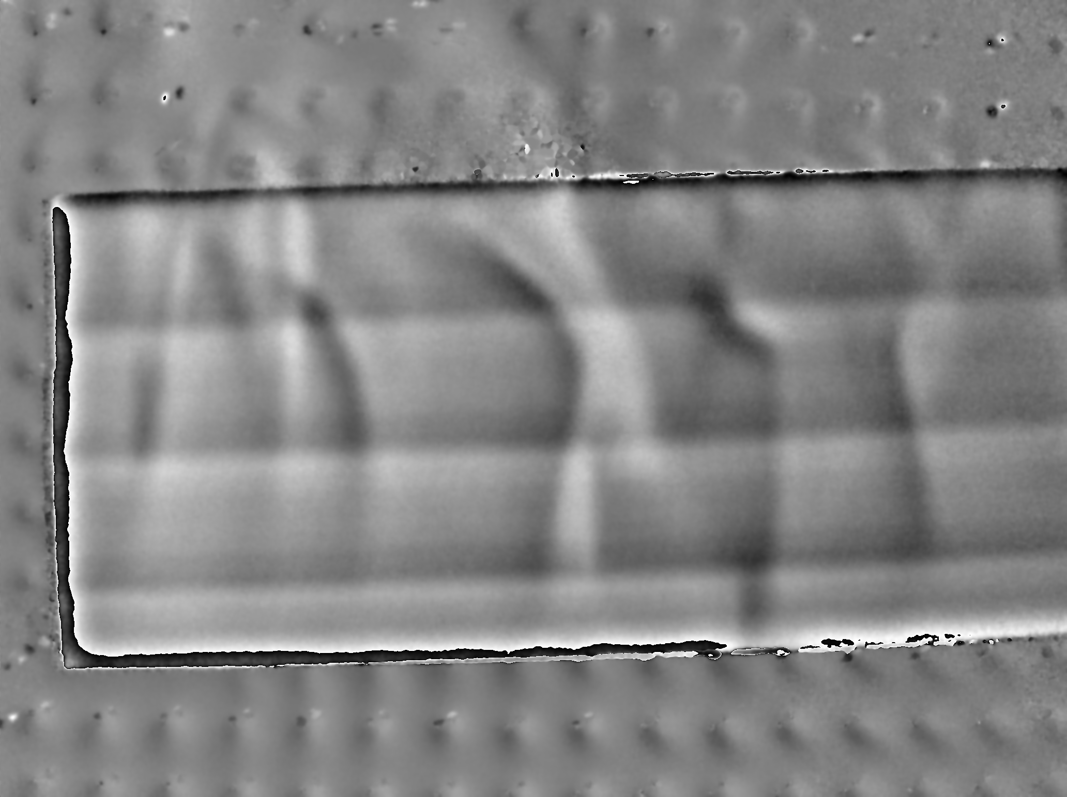
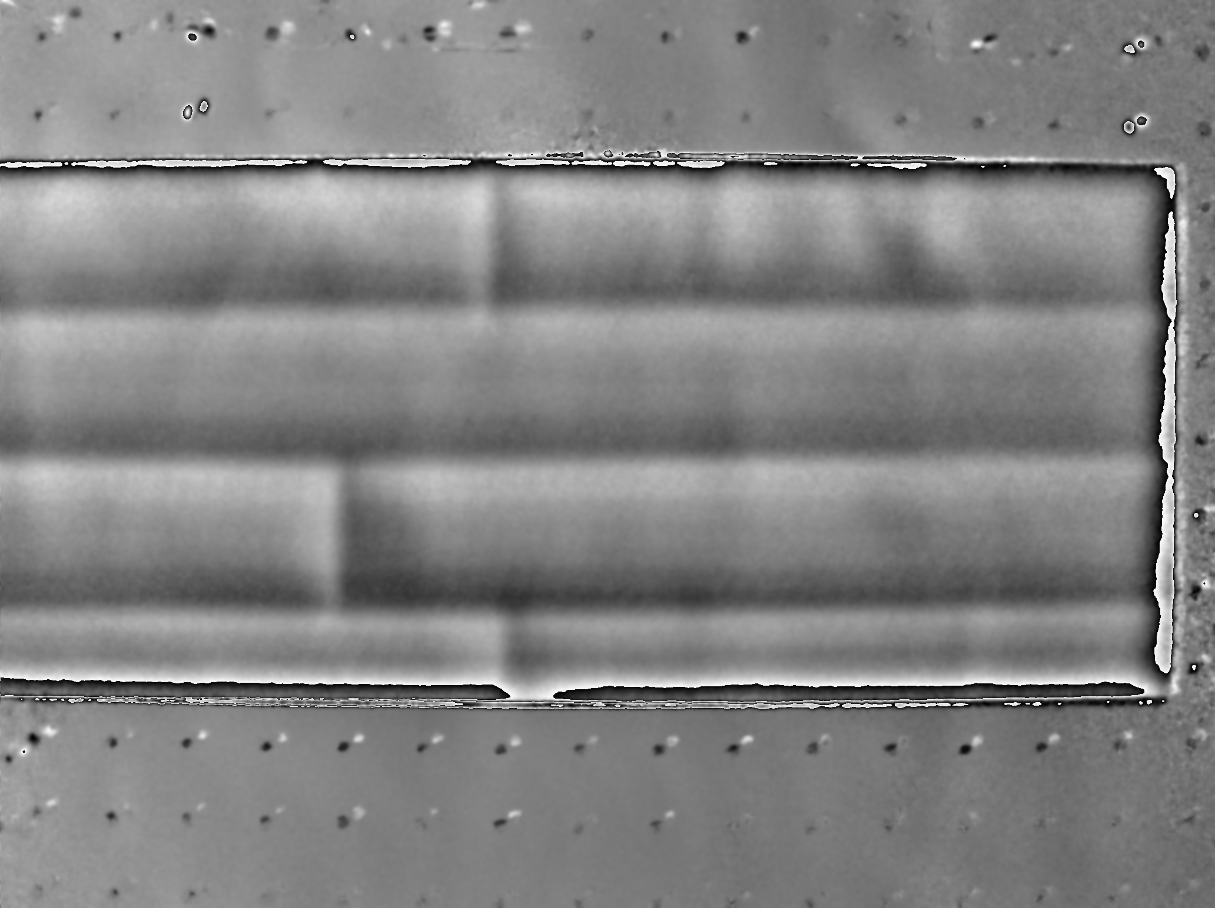
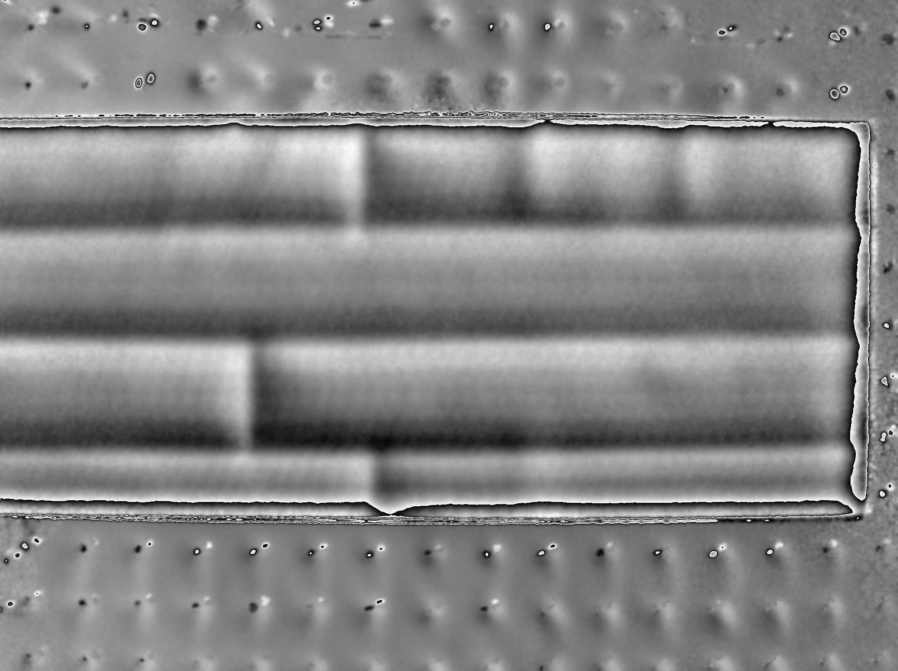
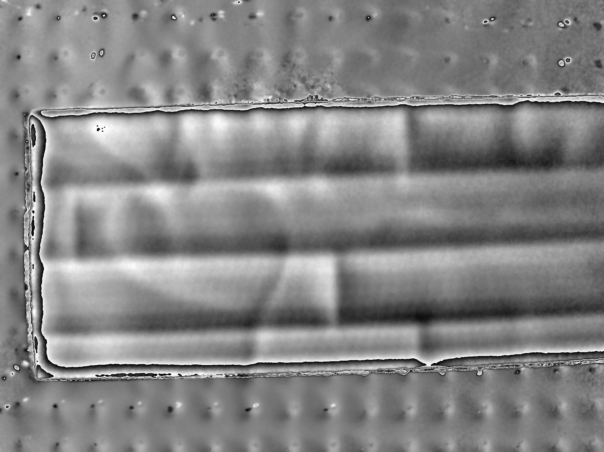
Phase Display Results
Test Method | Vacuum (Ambient) Excitation 0 kPa >> 5 kPa >> 10 kPa >> 0 kPa Shear: 5 mm @ 45° Distance: 700 mm (27.6 ‘’)
Display Properties | Accumulated Phase Display LP: 3.0 Px / HP: Off / Display Range: Off / Transparency: 0%
Field-of-View | 360 mm x 360 mm (14.2 ’’ x 14.2 ’’)
Duration of Inspection | 10 seconds*
Inspection Rate | 0.8 m²/min (8.4 ft²/min)
Shear: 5 mm @ 45°
ΔP: 5 kPa
Shear: 5 mm @ 45°
ΔP: 10 kPa
Shear: 5 mm @ 45°
ΔP: 10 kPa

Slide 22
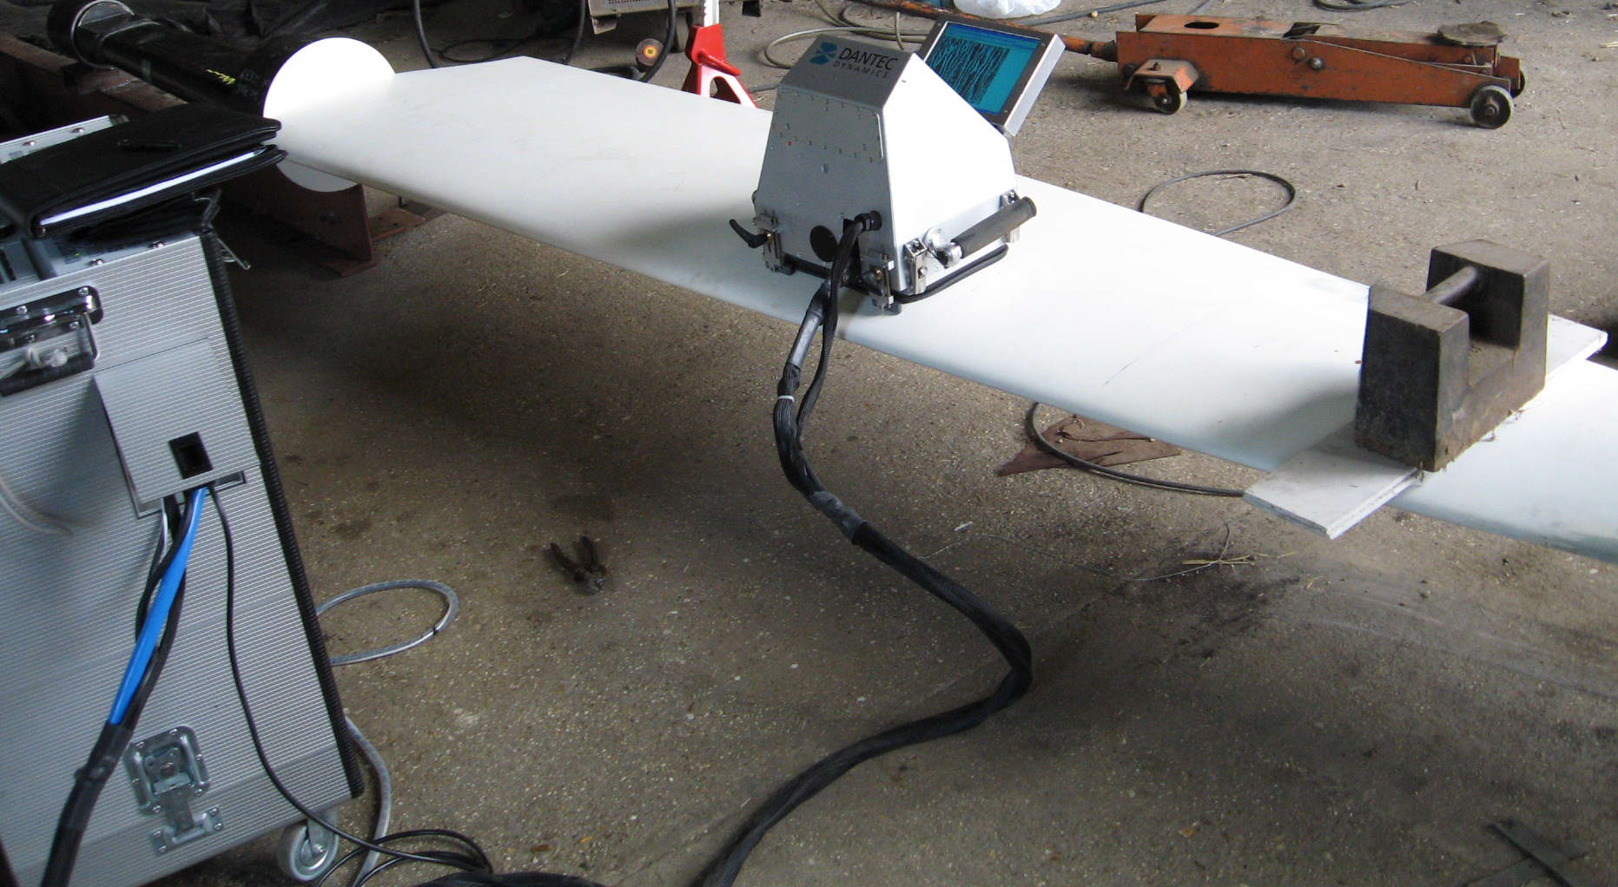
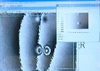

Rudder – CME Bondline Investigation
Test Method | Mechanical & Vacuum (Partial) Excitation
Verification of core-to-skin bondline on a racing yacht. Bending tests were conducted under various loading regimes. | Accumulated Phase Display LP: 3.5 Px HP: OFF Display Range: -π to +π

Slide 23






Broad Range of Shearography Applications
Impact Damage/s in Blades / Aluminium Honeycomb
Embedded Foreign Objects in Elevator / Aramid Honeycomb
Fluid Ingresses in Solar Arrays / CFRP Honeycomb

Slide 24
Thank you for your attention!
And talk to you at our Dantec Dynamics booth
With courtesy

